Slide 1
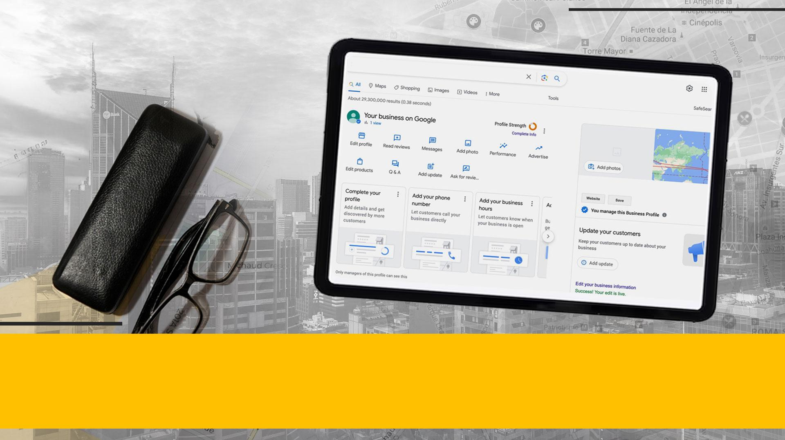


The Exact Changes We Made To
UNFILTER A 'STUCK’ GMB LISTING

Slide 2

The locksmith space can be especially tedious from a GMB perspective. Verification aside, EVEN LEGITIMATE LISTINGS CAN SUSPEND ANY TIME, causing you to re-verify with Google through their painful support process. It’s a nightmare to deal with…
Knowing the most efficient process to overcome filtering will reduce your listing’s downtime - and avoid lost revenue.

Slide 3
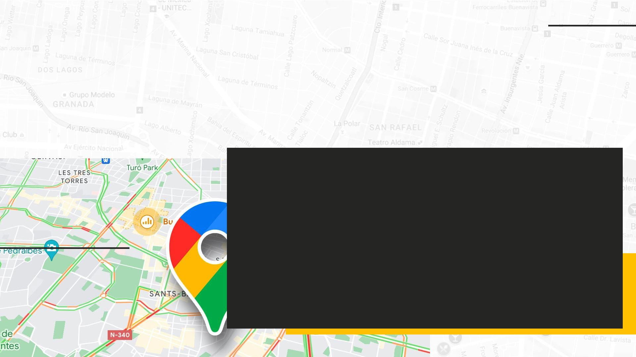
How to Overcoming Filtering
Issue numero uno was the situation we had with this client specifically…
The business had two verified listings in the same city - both were filtered. Their organic visibility was also low, adding to the already challenging issues.
1.
2.
3.
Pull the GMBs out of the filter that was keeping the listings in limbo and not eligible to show up in the three pack
Once the listings weren’t being filtered we needed to rank them for commercial queries that generate profitable calls.
Last, but certainly not least, we needed to increase their organic visibility to bring in even more leads.

Slide 4
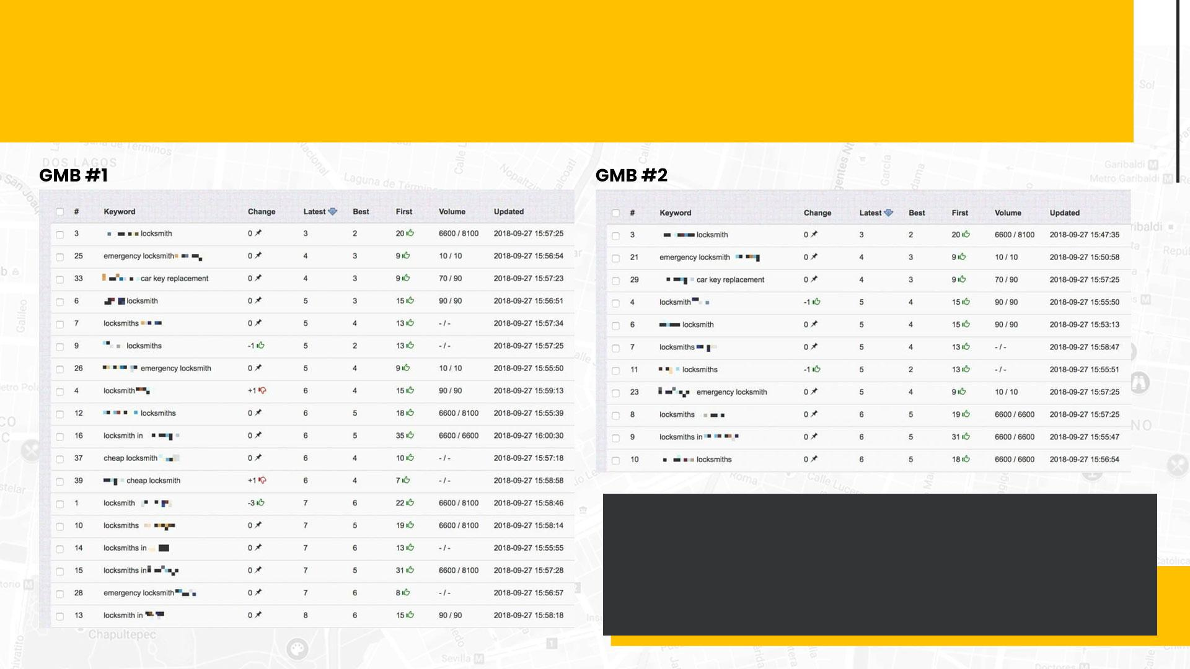
AFTER APPROXIMATELY TWO MONTHS,
THESE WERE OUR RESULTS…
The significant progress we made within the first two months demonstrated the efficacy of our strategy. The client was also extremely happy, because these rankings translated into an impressive INCREASE IN PHONE CALLS.

Slide 5
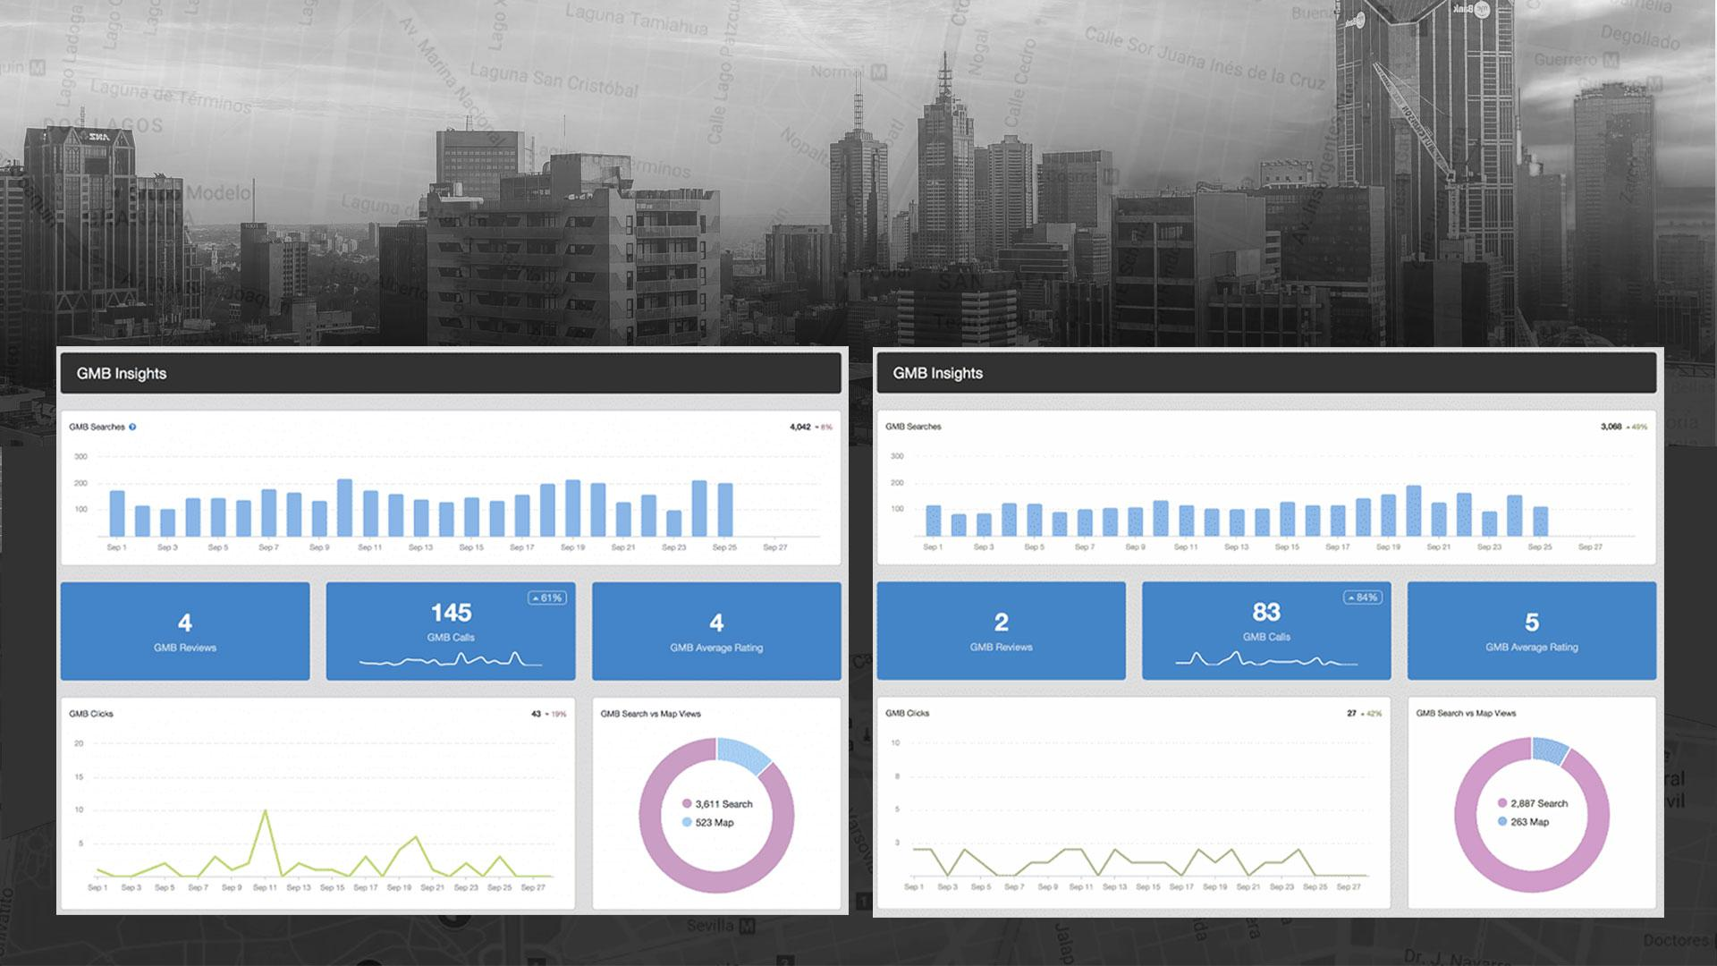
MONTHLY LISTING ENGAGEMENTS
AFTER FILTERING ISSUES SOLVED

Slide 6

LOCAL CANNIBALIZATION
WILL KILL YOUR VISIBILITY
Next, we needed to address the local cannibalization. Oftentimes, businesses accidentally over-optimize their website and listings. If you target areas with overlap, you’ll end up competing with yourself and dilute your brand’s visibility.
It’s an extremely common issue plaguing more service-based businesses than you would imagine! It’s a critical issue that must be addressed.
When we took over this client the pages on the site looked like this:
domain.com/locksmith-north-cityname
domain.com/locksmith-south-cityname
domain.com/locksmith-east-cityname
domain.com/locksmith-west-cityname

Slide 7

HOW WE SOLVED OUR
VISIBILITY ISSUES…
The 4 hyper-local pages each had their own respective listing, which was the incorrect structure. Google hated that there was location overlap, leading to the LISTINGS NOT BEING SHOWN IN MAPS. We pointed all 4 listings to the main city page, instead of their corresponding pages. We still kept and optimized the 4 hyper-local pages, but linked them back to the main city page to better guide Google bots.
On-page was meticulously performed to MAINTAIN THE JUICE AND GEO-RELEVANCE from other pages. After all, we want to fix the issues, not create new ones.
Lastly, it’s crucial Google knows each page is necessary and serving a very important purpose. If we do not indicate that these pages being broken up are conducive with a better user experience, then we will recreate cannibalization issues and our rankings could potentially suffer

Slide 8

An improper service area radius can COMPLETELY FILTER RANKINGS if not setup correctly.
This business had multiple listings with overlapping service areas, which we have found to cause issues with filtering. We mitigated this by manually inputting the zip codes that each listing served, ensuring no 2 listings had the same zip code.
USING ZIP CODES FOR SERVICE AREAS ia an important ingredient that helps us unstick listings. If you have multiple listings in the same metro, we highly recommend it.
Many service-based businesses want to hyper-target suburbs, but mistakenly end up creating clusters of listings with overlapping service areas. Don’t let filtering haunt your business!
Use zip codes to overcome these obstacles and keep listings safe.
AVOID FILTERED LISTINGS WITH SERVICE AREA RADIUS
Live And Die By The Radii

Slide 9

BUILD BRAND, BABY!
Do not forget schema and potentially taking your schema to the next level and adding objects like EIN#, founders, c-level executives, etc. These are the type of optimization activities that will pop knowledge graphs, increase brand authority, and help push local rankings.
We threw everything we could at this client minus a Wikipedia page. The team followed our GMB ranking guide to the word as far as the links we built and the optimization we did, with the addition of a few new tactics and the removal of a few as well. Stay tuned for our updated guide, coming soon.
We are preparing aftercare plans for our campaigns, an all-around knowledge base to help people bolster their campaigns. This will be laid out in much more detail there or even in a future entity building post, but taking the necessary steps to establish yourself as a real brand in the eyes of Google is the key to long term success in the SERPs.
This includes things like Wikipedia pages, Dun and Bradstreet listings, Better Business Bureau profiles, etc. GPS and In-Dash navigation system submissions which not only get you backlinks but having your business data accessible to GPS software like TomTom, Magellan, etc. increases the probability of you providing a better customer journey.

Slide 10

DON’T SKIP OPTIMIZATION…
Listing optimization might seem like a lackluster conclusion to un-filtering listings, but it’s one of the BIGGEST MISTAKES we see. While businesses focus on finding the magic solution to propel them up the SERPs, they overlook the basics that lay a strong SEO foundation.
Don’t overlook CRITICAL ELEMENTS. Make sure your listing descriptions are built out, the categories are correct, the listing is complete, etc. Always start with the basics and work up from there. You can’t build a strong house without a solid foundation…
This includes things like GMB posting, setting yourself up to get some reviews (keyword rich reviews are moving some needles at the moment), adding and optimizing images, etc.

Slide 11
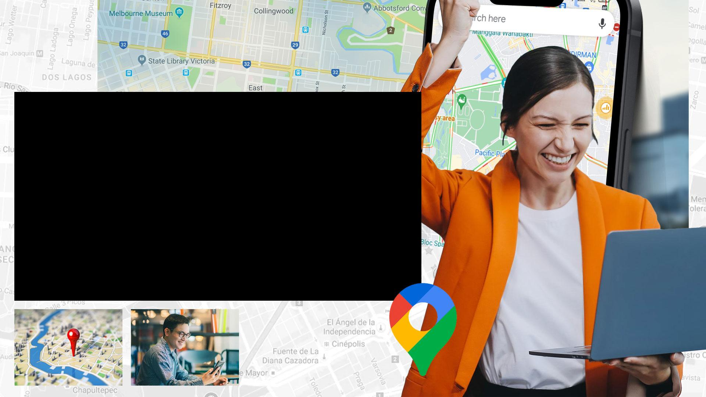
Short on time?
LET US DO THE WORK…
Don’t waste hours spinning your wheels! Our agency is experienced in overcoming these obstacles. After we completing this campaign, our client got 225+ CALLS PER MONTH!
You’ll cost your business VALUABLE TIME & MONEY trying to solve these issues yourself. The faster you address visibility issues, the sooner you’ll see increases in leads and revenue. Reach out to us today to get started!

