Slide 1

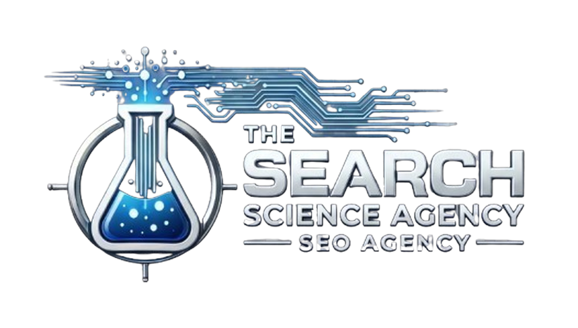
Tiered Link Building Case Study
HOW WE INCREASED ORGANIC TRAFFIC BY 63.58% FOR A LAW FIRM

Slide 2

One of the best ways to INCREASE RANKINGS AND AUTHORITY of websites is link building.
Establishing authority through backlinks significantly impacts the
overall SEO and performance.
Backlinks give websites the BOOST they need to rank higher and
increase organic website traffic when correctly paired with other SEO elements.
It is never this simple, however.

Slide 3

SEO IS NOT ABOUT
INDIVIDUAL TASKS,
but rather a complex combination of actions.
It’s about doing it all: technical optimization, competitor analysis, keyword research, content, and backlinks. Finding the right combination of SEO actions is what gets the website ranking. And missing one of those elements could be holding back the rankings. This case study demonstrates just that…

Slide 4

If you’re looking to increase
website visits and online presence,
continue reading about how a
law firm used our Link Building campaign
with 10 hours of Custom Signals and
achieved strong results, greatly
increasing organic traffic and new users.
This case study shows how you can
leverage our services to gain
more business for your company.

Slide 5


RESULTS FROM OUR LINK BUILDING CAMPAIGN
Ranked 28 keywords from positions
6-18 to top 5 (some even in top 3 positions)
63.58% increase in organic traffic
in the first 3 months
15.77% increase in monthly new organic users
77.45% increase in quarterly new organic users
1820 more clicks than the previous 3 months
Additional 2,305 incoming users/leads
(62.76% increase)

Slide 6

INITIAL DATA
The website already had established rankings; however their 3 target pages had keywords hovering around position 6-18. These are not bad positions, but pushing these keywords to top 3 – top 5 would potentially bring the business MANY MORE LEADS.
Most clicks occur in the top 5 positions.
If your business isn’t ranking in these spots, YOU’RE MISSING OUT on a huge portion of potential traffic, clicks, and revenue.

Slide 7


KEY FINDINGS FROM ANALYZING 4 MILLION+ SITES:
The #1 result in Google’s organic search results has
AN AVERAGE CTR OF 31.7%
The #1 SERP result is
10X MORE LIKELY
to receive a click compared a page in #10 spot
ORGANIC CTR FOR POSITIONS 7-10
IS VIRTUALLY THE SAME
Therefore moving up a few spots on the bottom of the
first page may not result in more organic traffic

Slide 8

MANAGED LINK BUILDING
CAMPAIGN
Our team manages the ENTIRE link building process for you, while you sit back and watch the impact of your campaign’s results. Our strategies are custom made for each client and their niche. Our process includes:
Technical SEO Audit
Anchor Text Ratio Audit
Future Link Mapping Strategy
Competitor Analysis
Matching Brand with Backlinks
Creating Content
Anchor Text Optimization
Manual Outreach and Link Placement

Slide 9

When you work with our link building team you get;
Diverse Set of Niche Relevant Link Types
Outreach Guest Posts
Curated Niche Link Placements
Do-Follow Media Mentions and Brand Links
Tier 2 Links and Link Indexation
Anchor Text Ratio Audit
Future Link Mapping
Data Studio Setup
Link Indexation
For the client, this meant that they would get high traffic guests posts and niche link placements for maximum results in the fastest time possible.

Slide 10

ADDITIONAL 10 HOURS IN CUSTOM SIGNALS
If you’re looking to increase nationwide brand presence or rank in more competitive industries/locations, additional hours in custom signal creation can give you the added boost you need to succeed. We take your off-page brand promotion even further with;
National SEO Niche and Authority Signals and Outreach
Competitor Backlink Opportunities
Competitor Brand Mentions
Even More Niche Link Opportunities

Slide 11

The website audit didn’t find any major flaws in the site itself. Page titles were slightly over-optimized, but other than that, on-page optimization was in place. The target pages looked good and had a decent amount of quality content. All technical and on-page aspects were good to go.
The biggest challenge with the campaign was the client’s pages and suggested keywords for each page were not in line with search intent. The client wanted to use the same page to target a variety of keywords with different search intents, but this is how keyword cannibalization happens.
THE AUDIT OF THE SITE :
CHALLENGES
TO OVERCOME

Slide 12

Keyword cannibalization is a very common issue. In fact, correcting matching keywords and pages based on search intent is one of the MOST IMPORTANT STEPS. Getting it wrong will significantly “limit” the
campaign’s potential. This is exactly why we don’t proceed with a campaign until we are sure what target pages/keywords we are going after.
So we went back to the client and
explained our audit findings, then agreed on 5 pages to target, each with different keyword clusters. Correctly mapping
keywords to the corresponding page/search intent is crucial to maximize
ranking impact.
Now, it was all about planning and
executing a link building strategy.

Slide 13

OUR LINKING BUILDING
STRATEGY
To maximize the impact, you must combine the link with the correct, optimized anchors. However, using too many of one anchor type or over-optimized anchors can negatively affect rankings. It’s important your SEO agency understands how to best leverage anchor text.
If you are unsure of what anchors to use…
Our team is extensively trained in creating the best anchor text for link building.

Slide 14

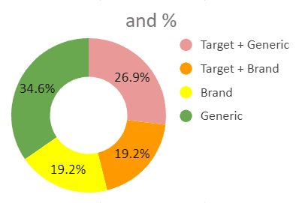
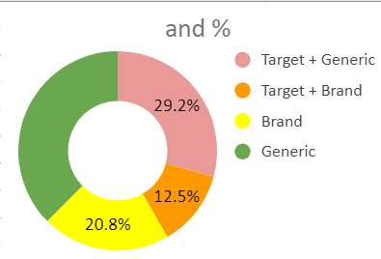
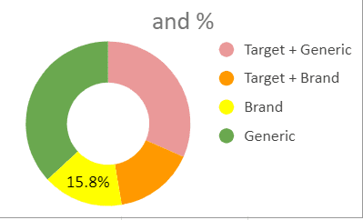
ANATOMY OF EACH PAGE…
PAGE 1
PAGE 2
PAGE 3
Guest posts: 5
Niche placements: 6
Anchor ratio:
Guest posts: 5
Niche placements: 6
Anchor ratio:
Guest posts: 5
Niche placements: 6
Anchor ratio:

Slide 15
PAGE 4
PAGE 5
Guest posts: 5
Niche placements: 6
Anchor ratio:
Guest posts: 5
Niche placements: 6
Anchor ratio:

Slide 16

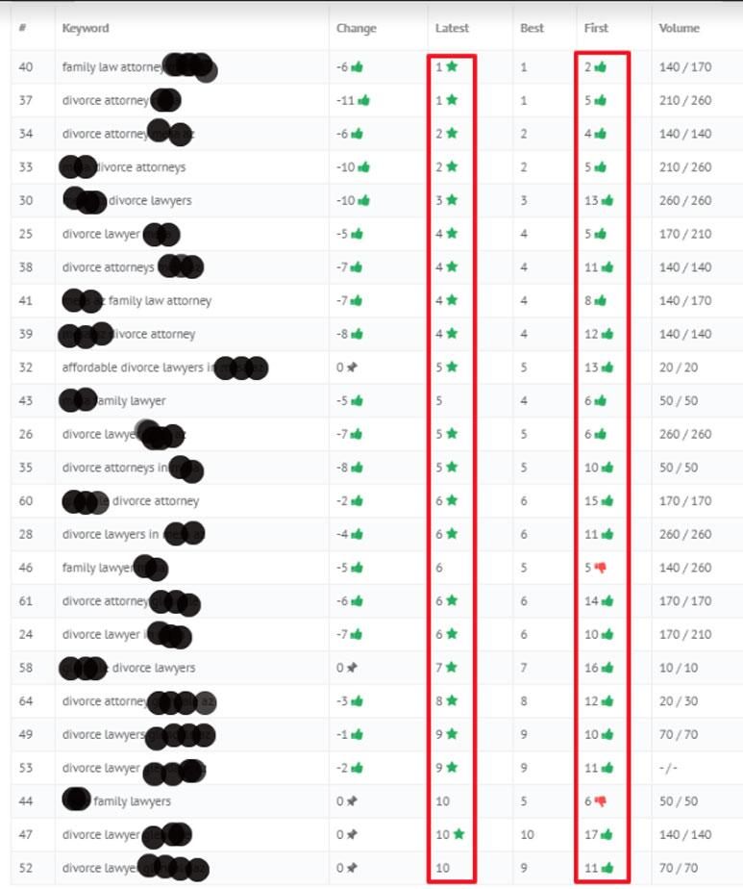
RESULTS OF LINK BUILDING
After 3 months of our link building campaign, we were able to PUSH 13 KEYWORDS from position 6-18 to the top 5. Many of the keywords ranked in the top 3!
You can see the best position, latest position (at the 3 month mark), and how the position changed in the chart to the right.
Many of these terms are highly competitive with substantial search volume. This enabled our client to INCREASE TRAFFIC, CLICKS, AND LEADS!

Slide 17

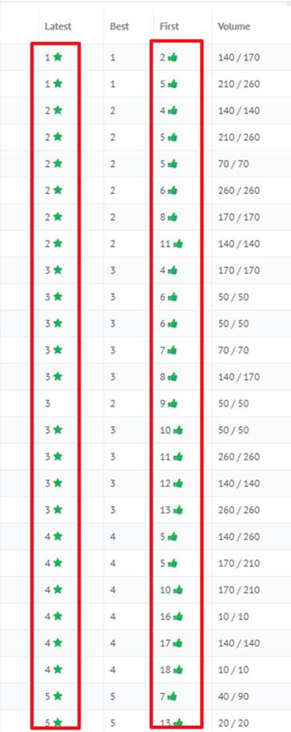
These ranking improvements lead to increases in the clicks and impressions of the website…
293,000 More Impressions than the previous 3 months
1820 More Clicks than the
previous 3 months
Improved average Click Through Rate (content better matched user’s search intent)
There were over 28 keywords in top 5, with 18 of those keywords being top 3, in month 5 of the campaign.
CONSISTENCY IS KEY!
Consistently building diverse and quality links in a natural manner ensures there will be a return on investment and
creates an authoritative
backlink profile for your clients, which then boosts rankings as seen below.
Our link building also expanded the number of keywords the pages ranked for. This is why the average position decreased, even though the positions of all target keywords significantly increased.

Slide 18

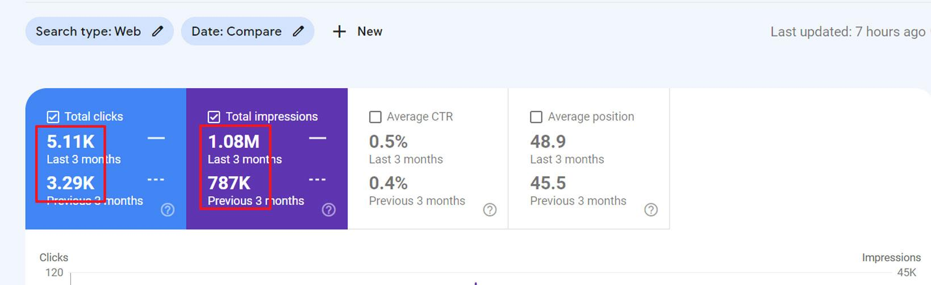
Thanks to the increased visibility and exposure, the law firm’s website saw a 63.58% increase in organic traffic over the course of the first 3 months. There was also a 62.76% increase in users to the site, bringing in an additional 2,305 incoming leads. Sessions also increased from 4,313 to 7,054 in 3 months.

Slide 19

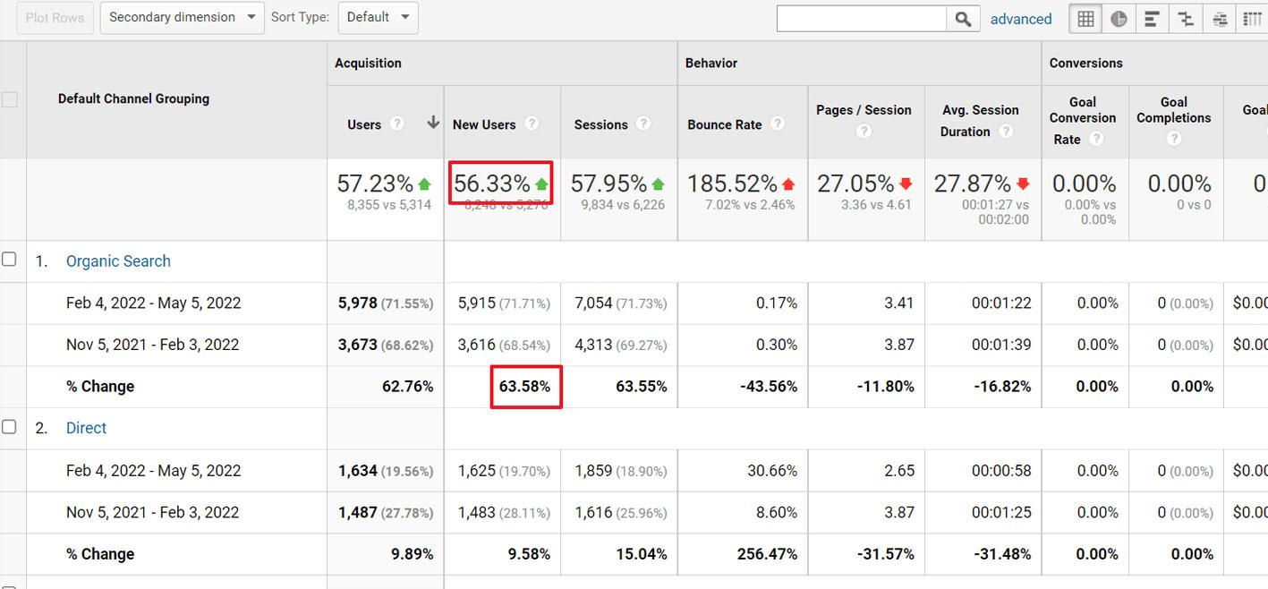
In the Google Analytics chart below you can see the growth in users over the first 3 months. This is sustained growth that continues to increase as the campaign progresses.

Slide 20

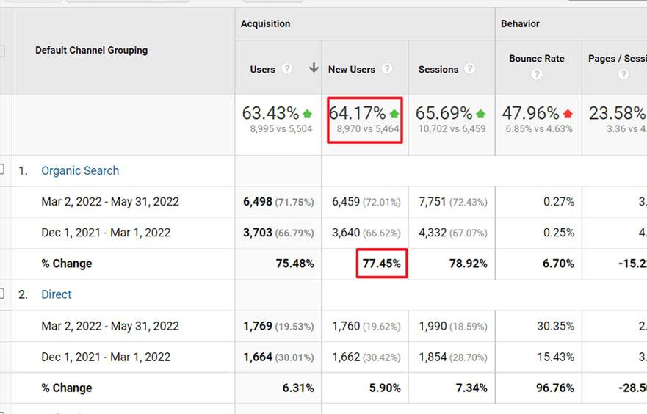
LINK BUILDING RESULTS
Over the first 3 months of our Managed Link
Building, we saw massive growth.
This investment resulted in:
28+ keywords in the top 5
(over half of which are in the top 3)
Additional 2,305 incoming users/leads
(62.76% increase)
63.58% increase in organic traffic

Slide 21

WANT RESULTS LIKE
THESE?
Simply reach out to us!
If you are uncertain of your SEO needs or which services to choose, our agency is always here to help you determine what you need to rank higher in the SERPs!
Let our team manually review your brand and determine exactly what links your business needs to succeed.

