Slide 1

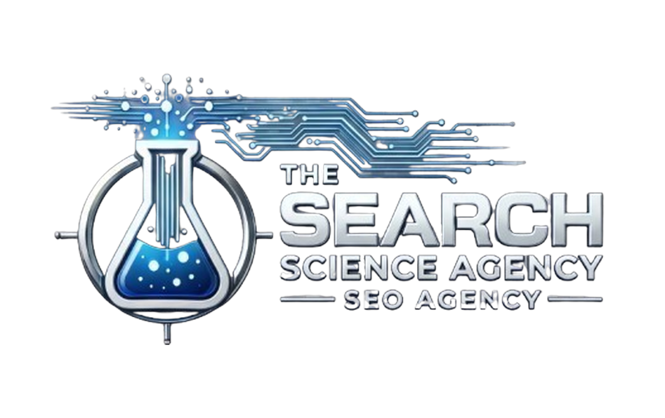
HOW WE ACHIEVED
MAP PACK
RANKINGS
FOR A MULTI-LOCATION SAB

Slide 2

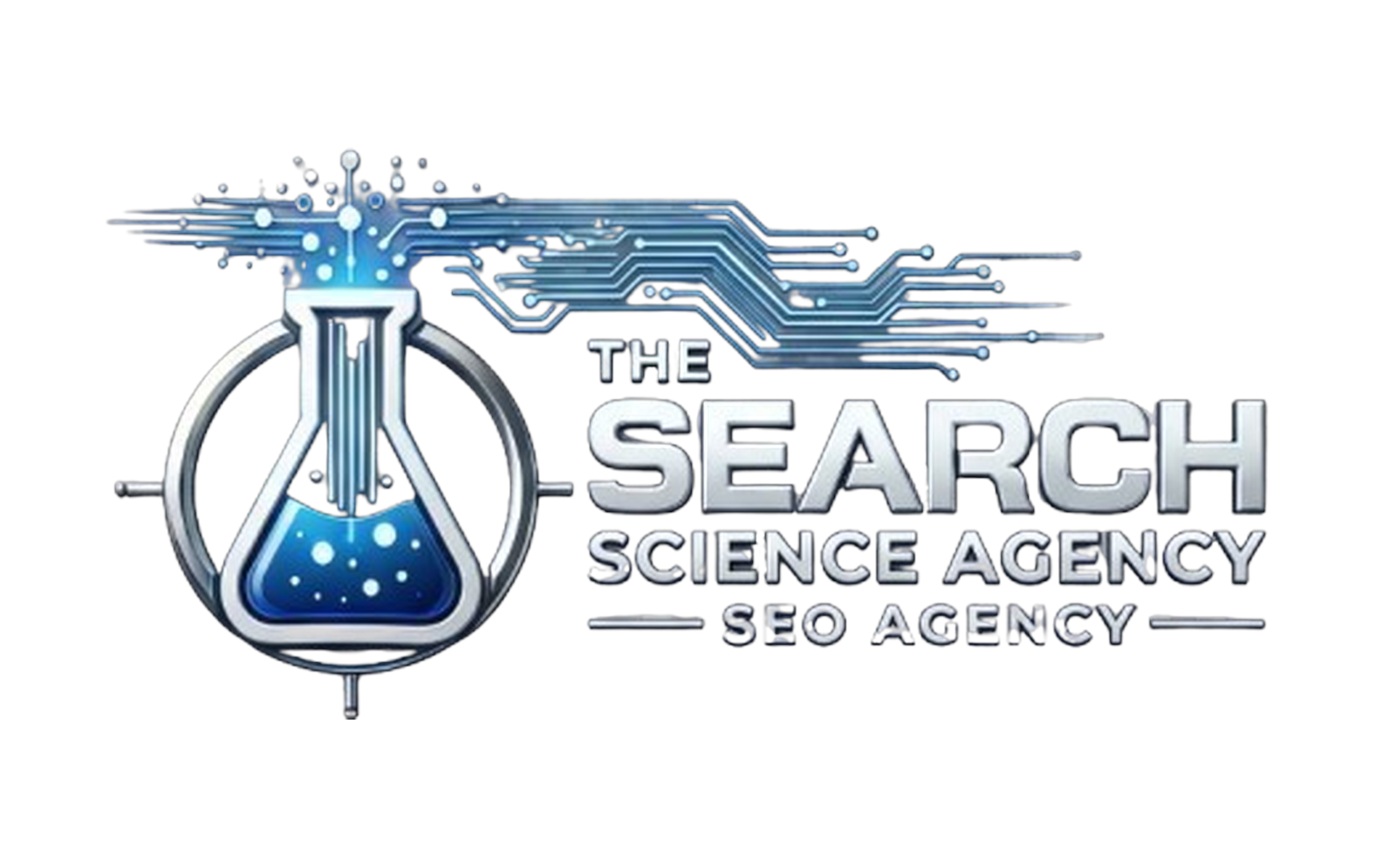
This case study will dive deep into the local SEO strategies that achieved map pack rankings state-wide for a multi-location business. Listing visibility in organic search skyrocketed nearly 500%, which led to a 400%+ INCREASE IN PHONE CALLS year over year. This boost in calls enabled our client to expand to more than 10 locations across their state.
Our optimization transformed a messy, inconsistent brand into a state-dominating presence for money terms – even beating out .gov and .org sites in the SERPs. This client is now the TOP-RANKING SITE STATEWIDE for a variety of high-value terms, and each of the company’s numerous GMB listings ranks in the map pack for their respective cities.

Slide 3


LET’S RECAP THE RESULTS WE ACHIEVED
FOR THIS CLIENT…
Nearly 2,000% INCREASE in Google Maps visibility, which attributed to all customer actions increasing – phone calls, driving directions and visits on website.
Increased phone calls by nearly 400% for multiple locations. For example, we grew from 127 calls to 580 calls per month for a single location.
450%+ INCREASE of their listing in organic searches, which drastically improved their online visibility.
Secured map pack rankings across geogrids for money terms, as well as the
#1 FOR HIGH VALUE KEYWORDS for all locations.
Our growth allowed our client to open additional locations and expand state-wide.

Slide 4

OPTIMIZING MULTIPLE
GMB LISTINGS
In the beginning of the campaign, we used our
ACCELERATED SETUP to strengthen the brand foundation and the local listings. Below you can see how we worked through each one of the these items for our client. Our local plan of attack included:
Ensuring Consistent Listing Types
Watching for Filtering (Possum)
Niche & Local Citations
Tiered Links for Stacked Signal Creation
GMB Category Optimization
Brand Foundation & Brand Signal Building

Slide 5

CONSISTENT LISTING
TYPES
When we began working with the brand, they had a mix of legitimate and lead generation listings. This created a few extra steps, which we were happy to assist with!
We worked with the client to create consistency across listings, clear up any fake listings, and reverify pre-existing listings where necessary. Once we knew the listings were consistent and following guidelines, we went to work optimizing…

Slide 6

WATCH FOR FILTERING & OVERLAP
This is a common issue in multi-location SEO campaigns. Listings can compete with each other, causing one of the two to be hidden in results.
To combat filtering, we went through each SAB listing, ensuring there was no overlap of service areas. We also made sure that our service areas were FULLY COVERING the proper cities/counties to maximize local relevance for the brand overall.

Slide 7

NICHE & LOCAL CITATIONS
& BRAND MENTIONS
Strong local SEO and citations go hand in hand. That’s why we implemented citation building, along with custom signals, for this campaign. Because this was a multi-location business, the citation audit and cleanup was vital to ensure NAP consistency across all locations and assets.
The audit also allowed us to see which locations were lacking in citations. While every location doesn’t need to have the exact same number of citations, we wanted to make sure we were spreading the love around. We also had to consider the competition level of each location. For example, Dallas is a much larger city than Flower Mound and more signals are needed to maintain adequate visibility.

Slide 8

Our process is to build citations in tiers, starting with the most impactful listings first. Once we have created all our ESSENTIAL CITATIONS, we then work on secondary citations. Keep in mind, SECONDARY CITATIONS alone won’t move the needle, but they do support increased brand visibility and authority. Generally, our next step would be niche citations, but we don’t have a citation package for this niche, so we moved on to investigating custom signals to find additional opportunities.

Slide 9

TIERED LINKS FOR STACKED
SIGNAL CREATION
After building the a variety of citations, we used tiered links to BOOST THE POWER of our citations. We used tier 2 links from news sites and budget link networks, but there are multiple TIER 2 LINKS to choose from. This tiered linking approach increased the authority of our citations, maximizing the impact of our optimization.
Improved indexation rates of citations is another benefit of tier 2 links. Most of the client’s citations were INDEXED QUICKLY because of this strategy, bolstering local rankings. We also included unique citation descriptions to increase indexation rates.

Slide 10

GMS CATEGORIES
When we began working with this client, they only had one category per listing, which didn’t fully leverage their GMB categories. During our competitive analysis, we identified the common subcategories among top-ranking listings, then implemented the BEST OPPORTUNITIES on our client’s listings.
GMB categories are one of the MOST important listing features – they’ve been proven to impact rankings in our SEO testing. But you also want to be careful not to add too many categories to your listing. For this client, we added both the primary categories and a few near-match secondary categories, because our client operates within a narrow niche.

Slide 11
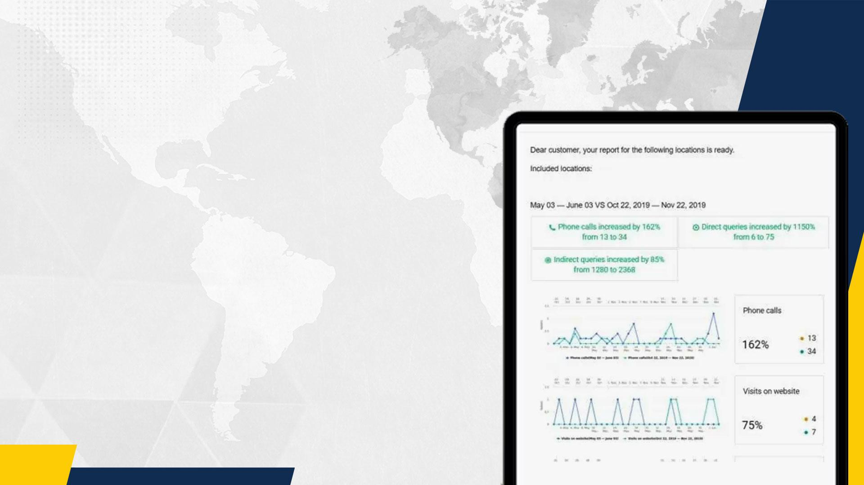
BRAND BUILDING &
BRAND FOUNDATION
CREATION
To build and strengthen your brand online, we include multiple branding features in our local SEO campaigns – brand foundation creation and brand boosting.
While brand building strategies may seem small, when combined they produce some pretty big increases. Here our some of the results of our local optimization year-over-year:

Slide 12

ON-PAGE
OPTIMIZATION
SEO FOR A MULTIPLE
LOCATION WEBSITE
CONTENT SILOS
In every DFY SEO campaign, we begin with a citation audit, backlink audit, technical audit and content audit.
Once we know where the client stands, we review their online brand with Google’s Quality Rater Guidelines. This is especially important in restricted niches, which this client is in.
INNER LINKING
PRESS
RELEASES
LOCAL & NEWS
LINK BUILDING

Slide 13

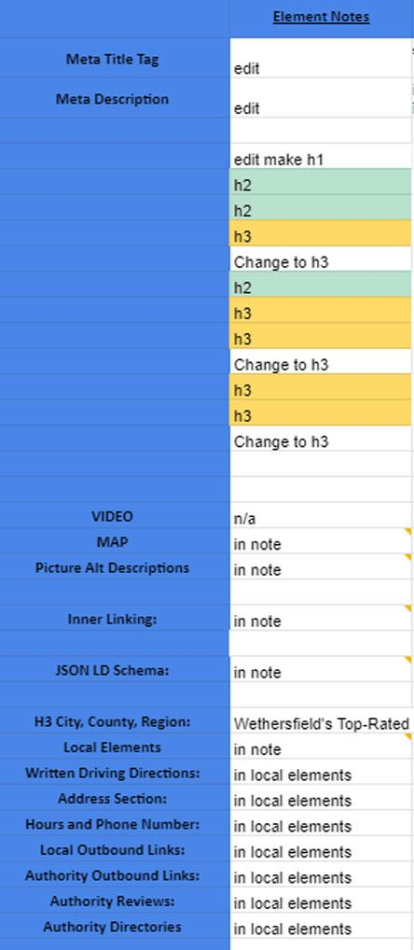

Title Tag
Heading Structure
Meta Description
Image Optimization
Adding Keyword Variation
ON-PAGE
OPTIMIZATION
During the initial campaign strategy session, we identified the top level pages to optimize. We based this on their highest converting pages and those that already had the most authority or relevance. Then, we plugged each into our on-page optimization workbooks to improve page features like:
To the left, you can see the items we review in the on-page optimization portion of our organic SEO campaigns:

Slide 14

CONTENT SILOS
Keyword driven content was also lacking with this client. There was blog content, but a well thought out strategy was needed.
We identified content gaps and laid out a content strategy to address these gaps. Each piece of content fit into a specific content silo in order to support rankings for top level service pages.
Many of the content pieces were created around informational intent, which started to build brand awareness early. In addition to the informational content, we also developed ACTIONABLE CONTENT items for what to do if you’re in specific situations.

Slide 15

Internal linking is always an integral part of our on-page optimization strategy, especially for multi-location clients. Our campaign linked heavily between service pages, location pages, resources and blog posts. Nearly all content benefits from a proper internal linking structure.
Pay special attention to your anchors when linking. Over-optimization of anchor text can counteract any work you’re doing, even when it comes to internal linking – make sure that you plan your anchors in advance where you can to avoid it. We also ensured non-contextual anchors were updated to be more relevant to the target page.
INNER
LINKING

Slide 16

LOCAL & NEWS
LINKS
We used press releases throughout the entirety of the campaign to boost authority and strengthen the link graph. We also used guest posts, custom signals, directories, sponsored links, and unstructured citations.
On a live page, this is one of the most important elements. Make sure you include your target term and a local modifier (for local brands) when making your title. The title also often becomes the URL, which is another IMPACTFUL FACTOR.

Slide 17

CREATE
CO-OCCURRENCE
WITH CONTENT
You can also use press releases, citations, and other links to create co-occurrence, which is exactly what we did with our client. We published content using variation and semantic keywords to associate our brand with these terms. The more content that referenced these variations, the stronger co-occurrence. We continued to leverage this strategy throughout the entire campaign and continue to do so.
As you strengthen co-occurrence for your main terms, you can begin to work in more long tail keywords that may be more distantly related to your brand. This will expand relevance and open the door to rank for more search queries. Ultimately your traffic, audience, and leads increase.

Slide 18

CUSTOM SIGNALS
Our client was able to overtake strong competitors who were heavily investing in SEO by acquiring some of the same backlinks. CUSTOM SIGNAL BUILDING is at its core a custom link building campaign, based on competitor link investigation. We spend 10 hours each month continually building local citations, links, and signals based on gaps with direct competitors. This allows us to not only rank you at the top, but also maintain these top rankings even if others are doing SEO. We stay ahead of the curve and continually build links without a huge time commitment from our team, in addition to our SEO testing.

Slide 19

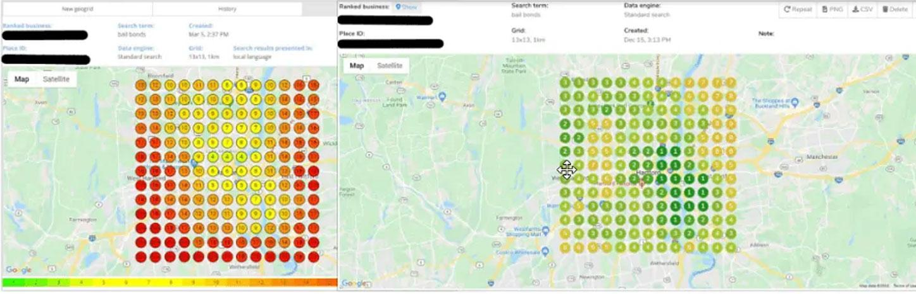
By including both local and niche related backlink research in our custom signals campaigns with the use of search modifiers, we are further able to maintain a competitive edge. This strategy FINDS CITATION AND LINK OPPORTUNITIES that could benefit your brand, but are not already linking to your competitors.
You can see above the massive maps increase that can be directly attributed to consistent custom signal creation.

Slide 20

CUSTOM SEO PATCH
& SOCIAL POSTING
Leveraging social media helps to build your brand and increase your prominence online while further helping to drive engagement with potential leads. GOOGLE RANKS BRANDS, so working a brand boosting element like social media posting into our campaigns is a no-brainer.
Monthly Patch posts were done for this business, focusing on a topic relevant to the niche. We also paid to boost the Patch posts for extra impact. Boosting is usually quite cheap, so it’s something we can work into a client campaign without eating up the budget.

Slide 21

AUTHORITATIVE
WEBSITE FEATURES & CUSTOM LOCAL SEO
Don’t allow missed opportunities on your website. Be sure your agency is leveraging all website features possible. For this campaign, we used:
FIND US LOCALLY SECTION
COUNTY PAGES
LOCAL NEWS
RELEVANT POINT OF INTEREST
OUTLINKS TO LOCAL/NICHE/AUTHORITY SOURCES

Slide 22


FIND US LOCALLY
On every location page we included a “Find Us Locally” to capitalize on trusted 3rd party reviews (signals). This strategy also highlights our 3rd party reviews, which Google uses as a local ranking factor.
Use the Find Us Locally section as a place to link to industry specific memberships that your brand is a part of, like the Painting Contractors Association (PCA) or attorney state bar association.
Below is a screenshot of the local review sites we used.

Slide 23

COUNTY PAGES
We were able to build local relevance for areas our client served, but did not have a locally specific address for, through the use of county specific pages on the website.
Each county specific page included:
350-word intro using our supporting terms.
NAP for each client location in the county
Link to the location pages for our offices in the respective cities of that county
Industry-relevant points of Interest in the county
Keywords with local modifiers

Slide 24


Here is an example of one county section on the homepage
HARTFORD COUNTY
Avon
Berlin
Bloomfield
Bristol
Burlington
Canton
East Grandby
East Hartford
East Windsor
Enfield
Farmington
Glastonbury
Granby
Hartford
Hartland
Manchester
Marlborough
New Britain
Newington
Plainville
Rocky Hill
Simsbury
Southington
South WIndsor
Suffield
West Hartford
Wethersfield
Windsor
Windsor Locks

Slide 25

LOCAL NEWS POST
You can broaden relevance by adding another layer of local content - local news. But we didn’t link to external news sites. Instead, we created our own blog posts around local news. Each post focused on news that was locally relevant AND related to our niche. For our client, we focused on news about courthouses, state laws, local committees and different law updates and changes because they’re in the legal industry.
Some examples of news posts include State Employees Left without Medical Leave, Jailhouse Witness Bill Turns into State Legislature, and the State’s Medical Marijuana Plan. Even bulk publishing, we saw a positive impact to local rankings.

Slide 26
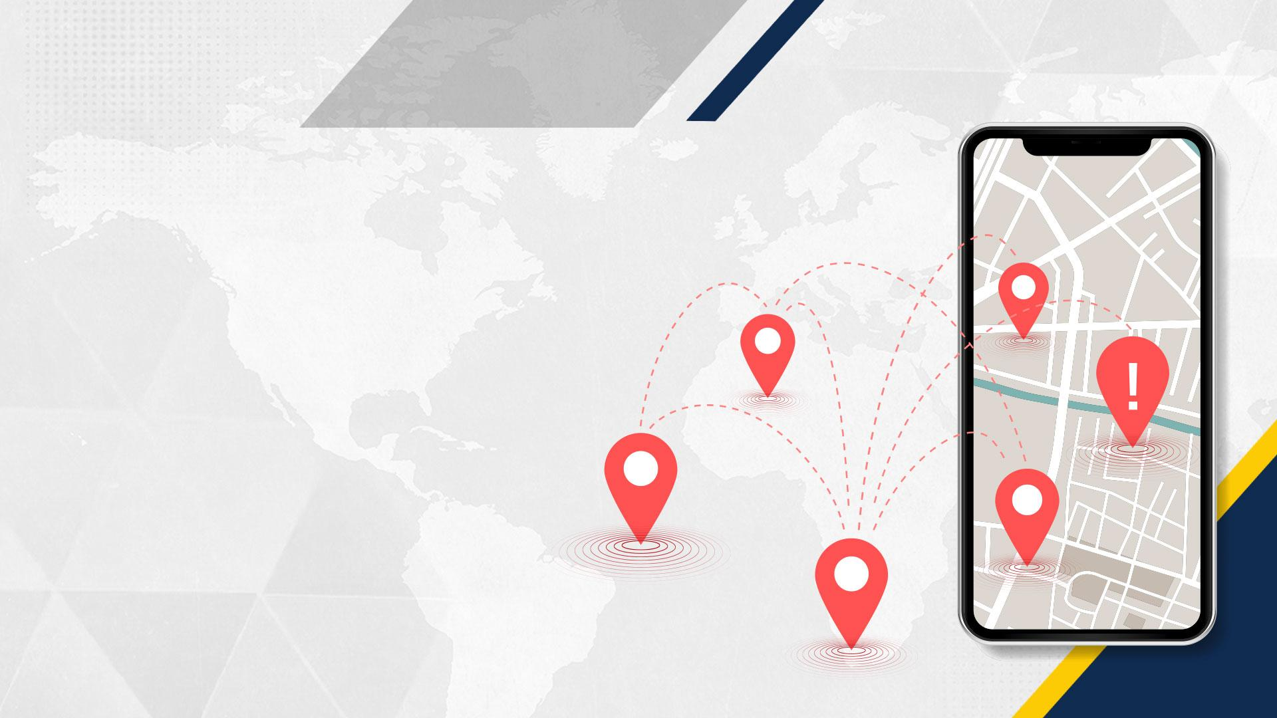
RELEVANT/HELPFUL
POINTS OF INTEREST
In addition to the local website features mentioned, we also included relevant points of interest on each location page. Because this business is in the legal niche, we included the court house, Supreme court, court clerk office and appellate court on respective pages. For each relevant point of interest we included:
Name
Image
Website
Address
Phone
Hours
Public Parking Info

Slide 27

OUTBOUND LINKS
TO LOCAL/NICHE
AUTHORITY SOURCES
Our client benefitted from the authority that these properties brought to their website, which added a layer of brand recognition and trust.
There are a wide variety of sources depending on your niche, so be sure to explore your options before linking. What are your competitors leveraging? Are there common outbound links amongst top competitors? These are all things you should look at while doing your competitive research.

Slide 28

Now that we’ve laid out our framework with state-wide domination, you’re equipped to achieve similar results for your business. Or, you can let us do all the heavy lifting for you!
We’re always here to help. Just drop us a message at {your email address} to discuss what options would be best for your business to THRIVE.

