Slide 1


How We Gained
454 New Sign Ups
96%
And Lowered
Lead Costs By
Software as a Service. It’s not the most difficult niche to rank for (compared to things like Gambling or SEO), but it’s still an industry that requires more finesse than the average business when it comes to securing valuable real estate on page one of search engine results. But with the right tactics, it is possible to grow your SaaS business in record time from the ground up.

Slide 2
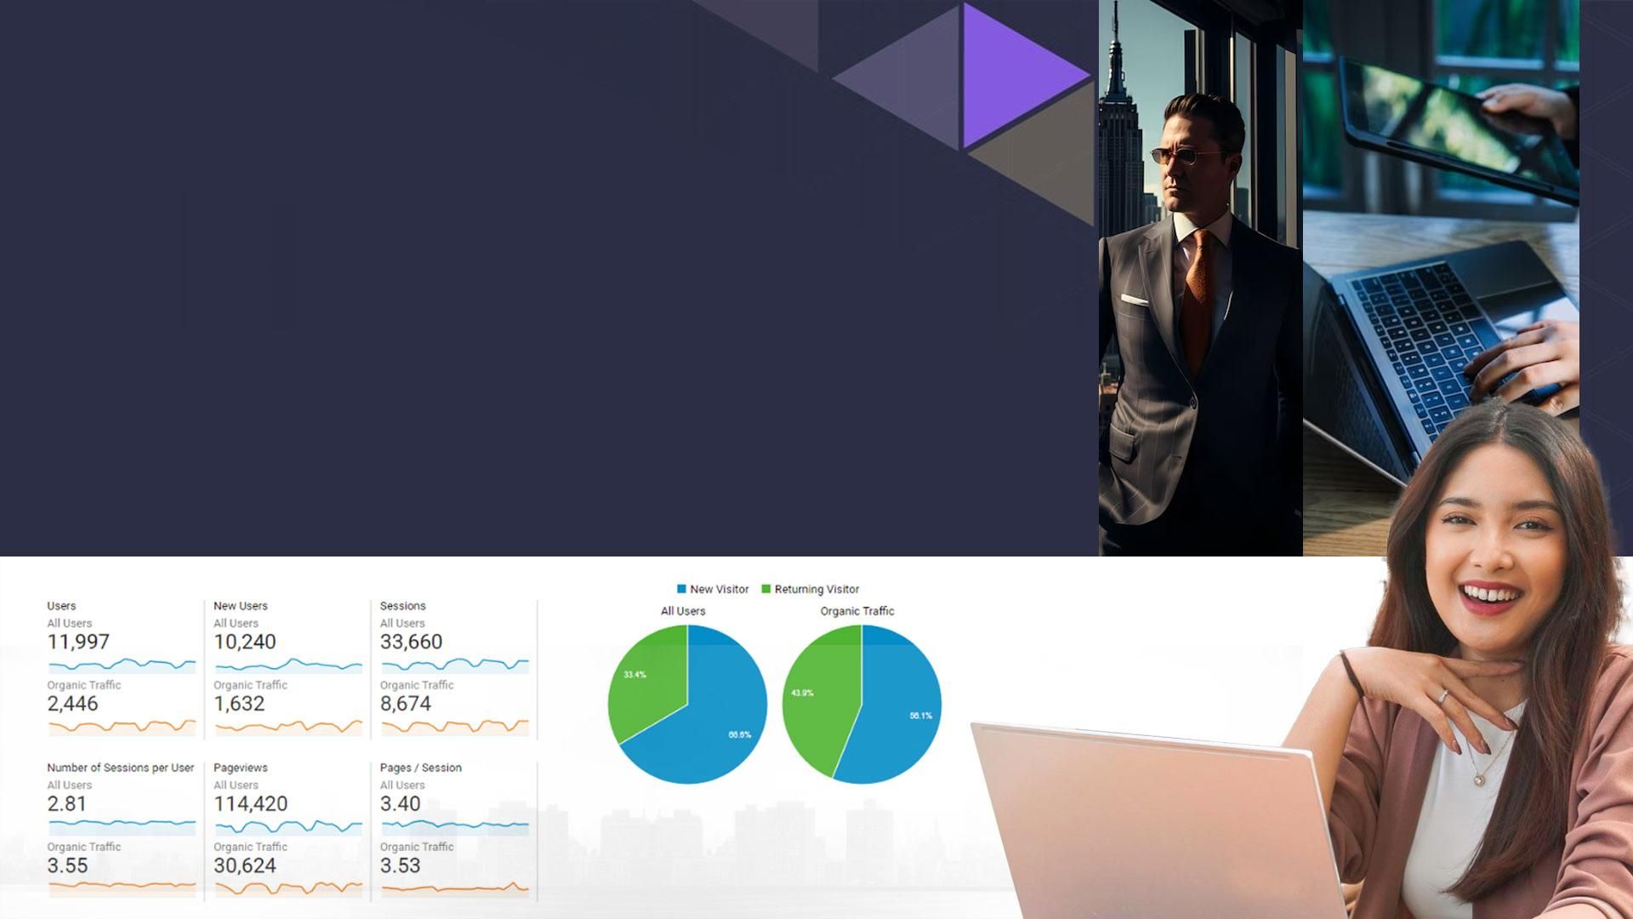
Minimize Your Monthly Acquisition
Spend With These Heavy Hitting Tactics
How does doubling, tripling, or even quadrupling the value of your website traffic sound? It doesn’t matter what your company does, that sounds pretty darn lucrative for a growing business! And for a brand new SaaS company, it’s almost unheard of to see that level of growth just out of the first year. Not only are we telling you that this is completely possible with the right strategy in place and an experienced team to manage it, we’re going to show you exactly what led to these major gains for what is now a very well known tool for local SEOs.

Slide 3

Notable Campaign Victories
Before we go any further, let’s share the huge wins that we got out of this campaign:
454 new user sign-ups from our campaign efforts
More than ½ of keywords ranked on page 1 organically
⅓ of monthly new
user sign ups from
organic traffic
25x our Total Goal
Value from campaign start to
end (14 months)

Slide 4

PART 1:
CHALLENGES
PRESENTED

Slide 5

Cataloging The
Challenges Of
Ranking A SaaS
Business
If you want to launch a company that offers software as a service, you first need to develop the software. You’re looking for a commodity, the Holy Grail of never before thought of software. Or maybe you’re just interested in breaking into a lucrative and diverse market where you see the potential to innovate. In the case of Local Viking, we wanted to do a bit of both. There were a lot of local rank trackers and plenty of outsourced GMB management, but nothing that included such clean and precise reporting along with rank tracking, GMB insights data, and post automation.

Slide 6

Building a fundamentally unique and easy to use software takes a lot of time and capital. And because you don’t want to waste those valuable resources marketing a software that is still in the developmental stages, your SEO budget will be smaller than it should be. The trick – and it’s no small one – is FINDING A BUDGET FRIENDLY solution that doesn’t cut corners or limit their services in order to give you that cheaper option. You might be paying less up front, on a monthly basis, but if it takes you longer to turn a profit on your investment due to low quality work or a sheer lack of quality SEO, you’ll end up paying more in the long term.

Slide 7

Let’s take a look at some of the roadblocks that could have kept
this SaaS business from ranking if they were not properly handled.
LOW ENTITY
As anyone who has launched a new brand or product can tell you, you’re nearly invisible at the outset. Once you start to grow your brand name and your online presence, you’ll be better able to connect with your target audience and grow trust with potential users. A fledgling product can be supported by a strong and recognized brand name, making it slightly more of a challenge to have both a new brand and a new software service.

Slide 8
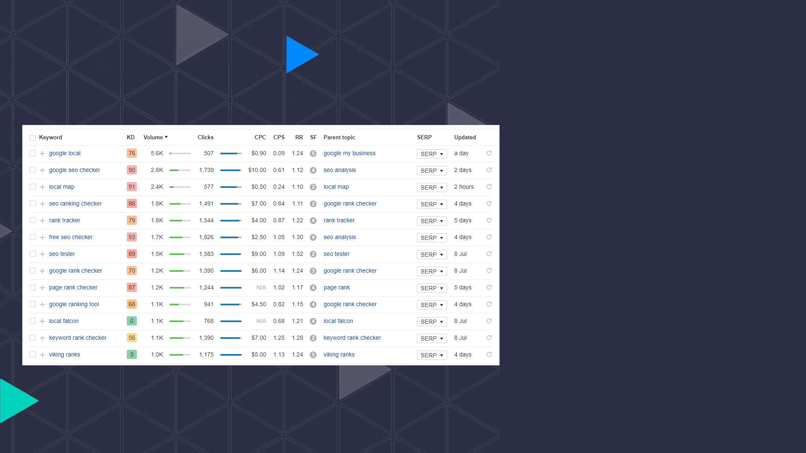
When you’re marketing a software, the entire world can be your target audience. That means that any similar software on the market now – or in the future – is your competitor. In our case, we’re looking at software from domains with more than a million total backlinks, many of which come from authoritative industry sites. Not to mention, we’re targeting terms that have search volumes ranging from 10, to 390, to 1900 monthly searches. That’s a tall order to fill, and realistically it could take years to get there, assuming our competitor keeps building backlinks and authority. Here’s an idea of some of the high volume terms we could rank for based on our focus terms.
COMPETITION

Slide 9
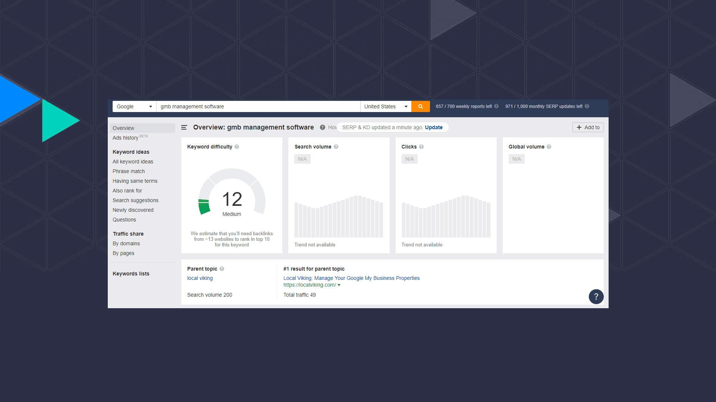
And just for fun, here’s the keyword difficulty score for ‘GMB Management Software’
which currently shows our brand as the parent topic!
In line with competition, it’s important to know the intrinsic value of our target keywords. Now we can see a glimpse of what our ROI could be if we were one of the top ranking sites for said terms. Some keywords are more valuable than others. Always aim to rank for the apples at the top of the tree, but don’t neglect the stepping stone advantage that you can gain from gathering the low hanging fruits as well.

Slide 10

LACKING CONTENT
A common issue that SaaS businesses need to combat – and one that ecom sites fall victim to as well – is a lack of keyword focused and optimized content. And this is crucial: KEYWORD. FOCUSED. CONTENT. Sure, content in general is important to your site. It helps search engines to know what your site is about to better categorize and rank your pages. It helps users to learn more about your brand and your software, why they need both and what they’re missing out on.

Slide 11

So we know that we need to WRITE CONTENT FOR SEARCH ENGINES, but we also need content that’s sincere and readable in order to interest real people who could become our clients. By choosing a Focus Keyword (more on this later), we can create content that revolves around the search term(s) that are most lucrative for us. If this is done right based on competitor parity for content length and keyword density, Google is going to see that our page talks about things that other high ranking pages – that it already favors in that field – are talking about, and it will reward us accordingly. In turn, these higher rankings will get us more visibility in SERPs, leading to more clicks.

Slide 12
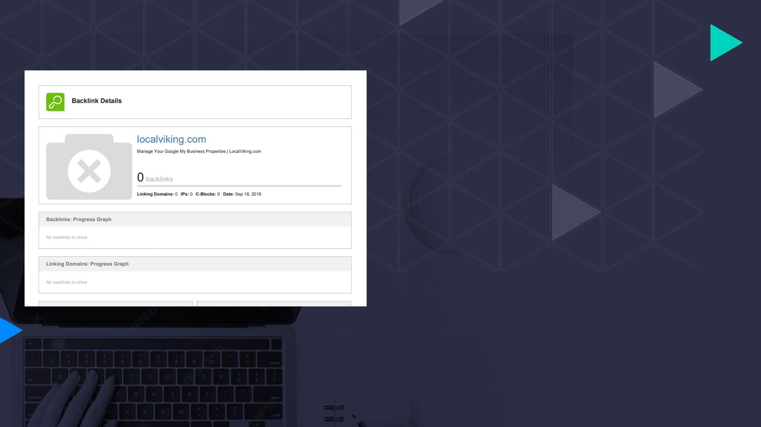
LACKING LINKS
A common issue that SaaS businesses need to combat – and one that ecom sites fall victim to as well – is a lack of keyword focused and optimized content. And this is crucial: KEYWORD. FOCUSED. CONTENT. Sure, content in general is important to your site. It helps search engines to know what your site is about to better categorize and rank your pages. It helps users to learn more about your brand and your software, why they need both and what they’re missing out on.
Next we’ll get into how we evaluated WHAT to address and WHEN while building out an effective campaign for a SaaS business.

Slide 13

PART 2:
CREATING
HIGH IMPACT
SEO
STRATEGIES

Slide 14

CREATING VALUE
THROUGH HIGH-IMPACT
SEO STRATEGIES
So what did we do about these challenges? We started a managed SEO campaign, of course. In a perfect world, we’d throw an entire arsenal at this site since we’re building from the ground up. But the software has only recently become available and we don’t want to overdo our link building right out of the gate. In this case, the Elite Level DFY SEO was a perfect fit for our budget and the amount of work that we needed to accomplish both within the first few months and beyond.

Slide 15
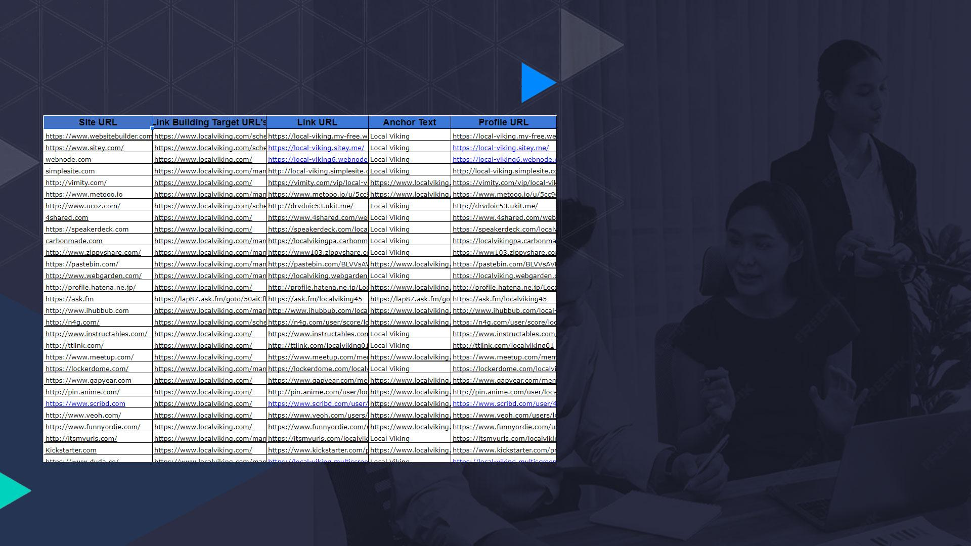
ENTITY BUILDING
First thing’s first, we need to get the word out about our brand before we can begin introducing users to our top of the line software. In many cases YOUR SOFTWARE IS YOUR BRAND, so you can optimize for both in tandem. Building this trust and recognition is paramount for a Saas business, especially one that has only recently entered the market. We knew that this would include a lot of Web 2.0 creations, and that it would make up the majority of the off site work in the first few months.

Slide 16

MONTHLY CONTENT
CREATION
Fresh content is a powerful resource for keeping your site in view and bringing in traffic. Our site has just enough content to get started. However, we’re just a raindrop in the ocean compared with aged domains that produce multiple articles at thousands of words every single month. As important as content creation will be to our overall SEO strategy, it is an exhausting process to continuously gather fresh topics and write wordy articles around focus keywords week after week after week. With everything else that launching a software entails, it was easy to leave this to the professionals behind our managed SEO.

Slide 17
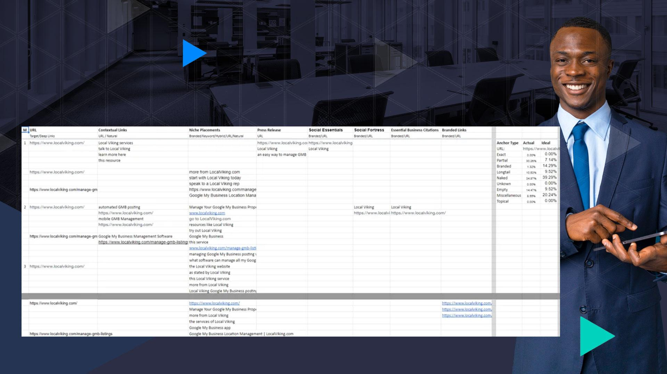
POWERFUL, POINTED LINK BUILDING

Slide 18

The best way to build your links will always be through MANUAL REVIEW AND OUTREACH. This is where you’re going to be able to snag some powerful, authoritative backlinks if you play your cards right and present a strong brand. Our link building efforts begin with our entity building tactics. It’s important that we include a variety of link types each month for a diversified and robust backlinks profile early on. We’ll be using techniques like press releases and brand profiles to get this healthy mix of links.
While we’re doing that, we can also create a FOCUSED LINK STRATEGY that allows for heavier keyword targeting on our most powerful links. This is crucial to a successful campaign. If we target the wrong pages, or use the wrong anchor text for the pages we’re linking to, we could end up causing ourselves a lot of headache not too far down the line with a sickly backlink profile that will haunt us further into the campaign.

Slide 19

RECURRING ANALYSIS
Have you added new services or pages to your site? Are your rankings improving for one set of terms but not another? Are you building too many links to a page, or to the site overall? These are things that our campaign managers ask on a quarterly basis when every project is expertly reviewed. No matter how large or how small your business, continuously devising new strategies and approaches to your SEO will keep you abreast of algorithm changes and help you overtop your competition. The periodical review sequence that we employ gives us the most flexibility in our campaigns. It means that we’re able to catch deep issues and address them much faster, or change our targeting more perceptively.

Slide 20
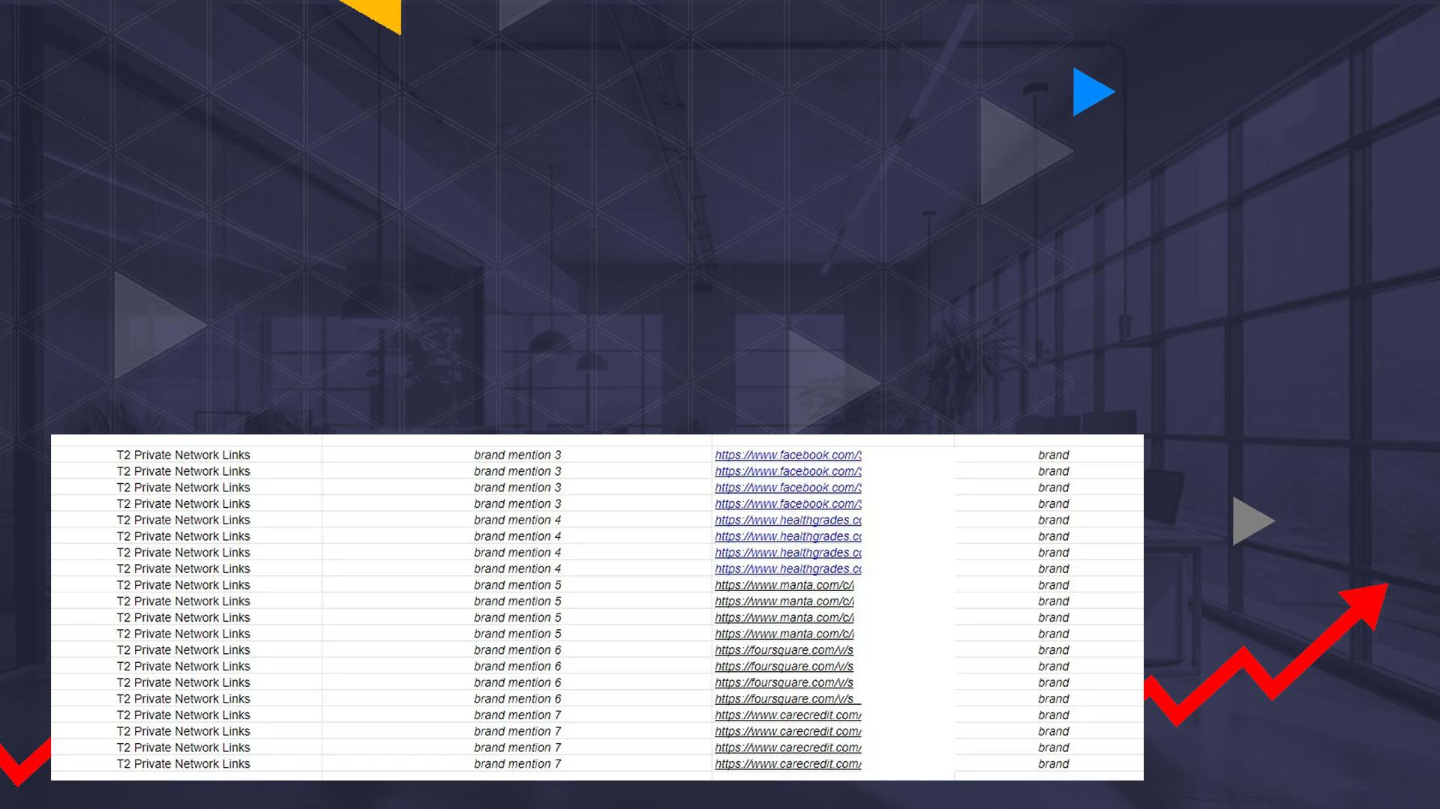
BOOSTING & MORE BOOSTING
Link building should always be taken to the next tier, especially when you’re operating on a lower budget. Tier 2 links are also a way to boost your existing brand profiles, which is a great idea if you’re a new company and/or having trouble with your brand visibility. While tiered links are the most common solution to boost a link, they aren’t the only one. Including a valuable link – like a brand mention or citation – into other link building tasks is also beneficial. By adding our best links to content, brand profiles, or press releases, we’re creating strong buffers that will help us get more link juice to our main site without actually making our money site pages top heavy with links. When we link build in this manner, we can also use more keyword rich anchors for that bonus relevancy factor.

Slide 21

PART 3 :
CRACKING
THE CODE

Slide 22

REVERSE ENGINEERING
THE COMPETITION
Now we can get into the real meat of this project.
A number of tactics went into getting our SaaS where it is today. But what SEO work had the biggest impact on our bottom line, why did it work, and how can you replicate the results for your own software or other business?

Slide 23
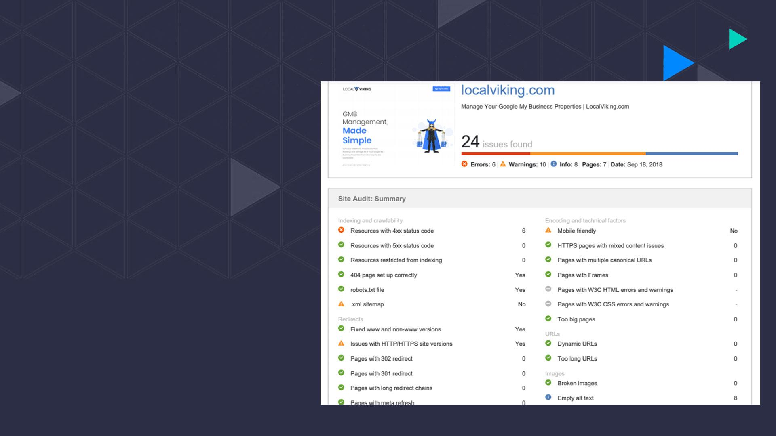
WORKING FROM
THE GROUND UP
Every managed campaign starts with a complete technical and quality audit. Once this has been completed we will have a better idea of the big picture for our ranking process. If there are quality issues like low content and authority, or technical issues like poorly structured URLs, these things could very well hold back our ranking process. Getting them out of the way early is going to lead to a more successful campaign. KEYWORD ANALYSIS for link building is also completed at this stage, which helps us to determine our focus keywords for our targeted content, our top pages, and our top competitors to beat.

Slide 24

From this report it’s clear that we were not suffering from any majorly concerning technical factors. However, the lack of a mobile friendly site version or xml sitemap were important things that we knew needed to be created going forward, so we could add these to our list of updates that the site would be getting in the first few months.
THE TECHNICAL AND QUALITY AUDIT for this site also came back with few results, although it was noted that the site could use additional content to line up with the current top ranking sites for the same keyword set. Even if you’ve just built your website from the ground up, running it through an audit is the easiest way to be certain that there are no problems with the site or updates that should be made.

Slide 25
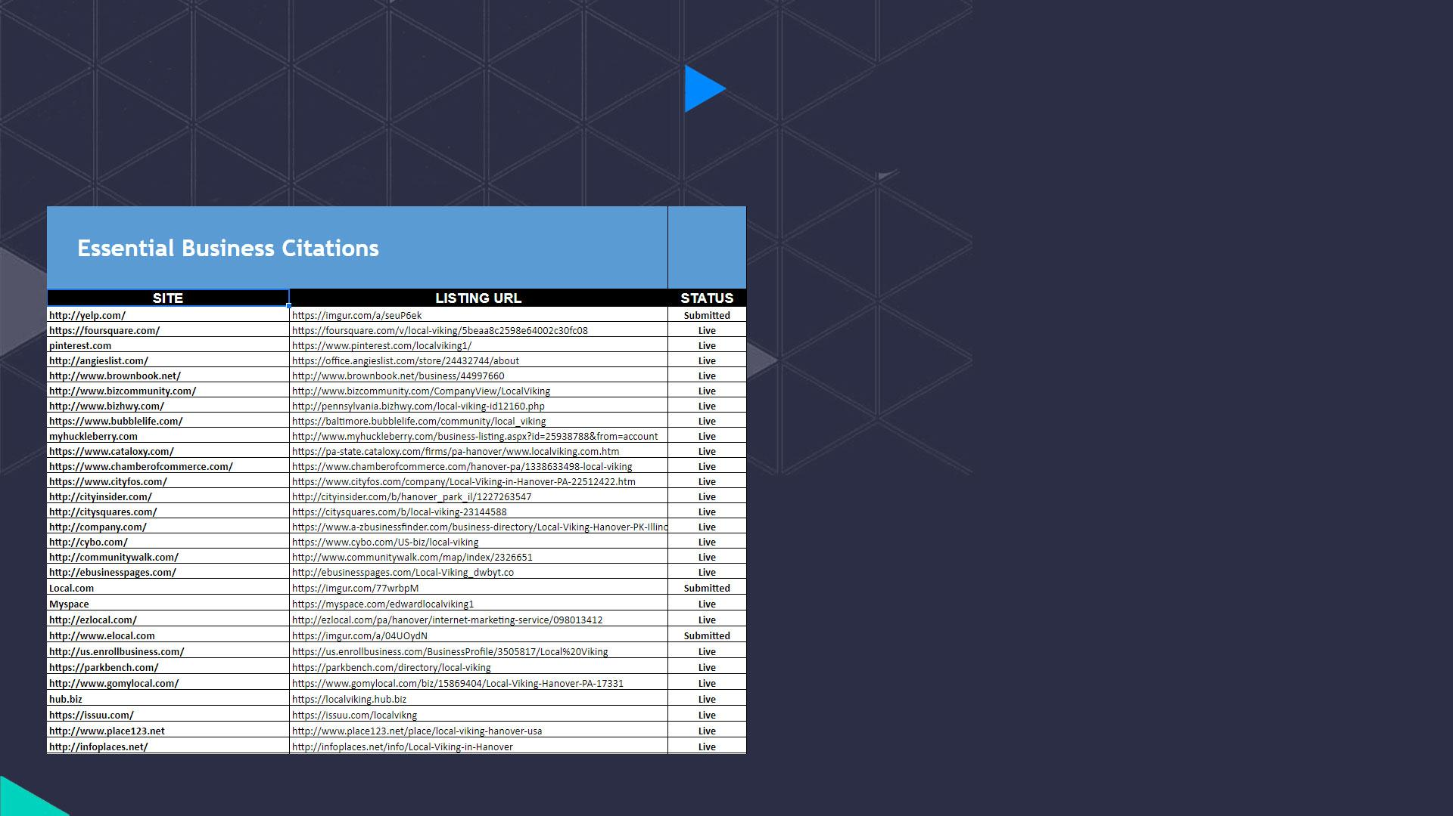
First thing’s first, we need people to know that we exist. To do that, WE NEED TO MAKE SURE THAT OUR BRAND IS PRESENT in as many places as possible. Tier one social properties and directories like Facebook, Yelp, and BBB are easy to get for a real brand and highly trusted by both consumers and Google. Besides being authoritative sources, these properties can also act as a platform for your business to gather positive reviews. A lot of our initial link building needed to be foundational to not only build up the brand, but to set the stage for the more intensive keyword focused link building we would be doing each month. Making sure that our backlinking efforts did not appear spammy to search engines required us to initially create a lot more links with branded or naked URL anchor text to link back to our site. On the other hand, we managed to get a ton of brand mentions or naked URL backlinks through the creation of our citations, which was an easy win.
BUILDING A BRAND

Slide 26

Social accounts and citations were all completed in the first two months. A PROPERLY OPTIMIZED PRESS RELEASE was also syndicated to announce the new software. Ultimately this would gain us 400-500 backlinks for the first quarter, all including our brand name and contact, as well as that naked link back to the site. Social accounts and citations that we created would also utilize the keywords that we wanted to target to build out the profile sections related to brand services, company description, and tags. Due to the non-localized nature of SaaS, citations were not of much importance for our campaign beyond the initial branding. However, it’s a good idea to look for more directories in your niche, where you can get a brand listing with a backlink. By building enough of these brand signals, you’ll start to dominate page one of Google results (at least for your brand name). Keep in mind, if you’re using a keyword name, it’s going to take you a lot longer to build your authority as a new brand.

Slide 27
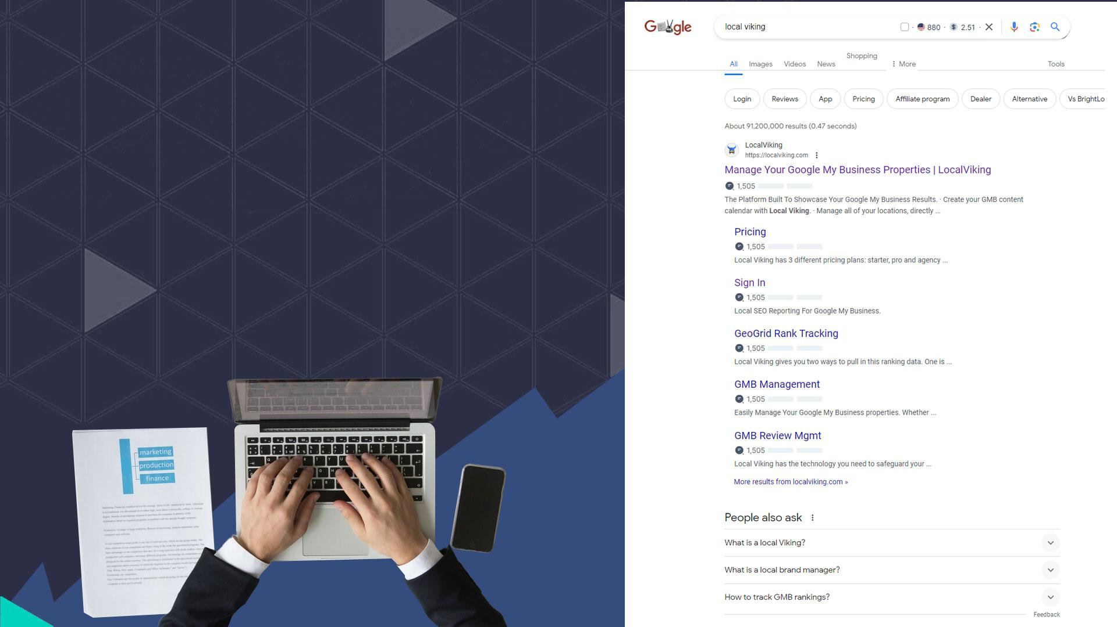
The final piece of the puzzle for this portion of the campaign is to make sure that our main target pages are up to parr. Technical and quality audits take us a long way through this process, but on page optimization will put the icing on the cake.
SEMANTIC OPTIMIZATION is our preferred method for better on page optimization, pulling both competitor rankings data and page content from the top sites to help us better optimize our own content and keyword buckets.

Slide 28

EXPANDING OUR REACH
SaaS is an increasingly competitive niche, thanks in part to the ever lowering entry barrier. Not to mention the tendencies for oligarchies to form due to the implementation of a dominance strategy approach. Because software companies are often not interdependent, and because there are only so many top tier enterprise clients to snatch up, SaaS industries become dog eat dog worlds with little room for new competition. These companies are not banding together for a ‘greater good’ in the way that tech giants are wont to do. Instead, this is an every-man-for-himself mentality that has driven the increasing difficulty of ranking for a new SaaS business.

Slide 29

What We Need To Do is
Expand Our Reach
Look at it this way. Top competitors for SaaS are, nine of every ten times, major players with decades of experience dominating their industry and millions in backing capital to put into their marketing, new product developments, support, and maintaining their existing software. In order to stand a chance of outranking these top sites, we need to have a well thought out and strategized link building plan. The more powerful the backlinks we are able to obtain the better. But we still need to be smart about how we’re using our anchor text. To give you an idea of just how competitive the SaaS industry is, check out the market share for some of the top software companies.

Slide 30
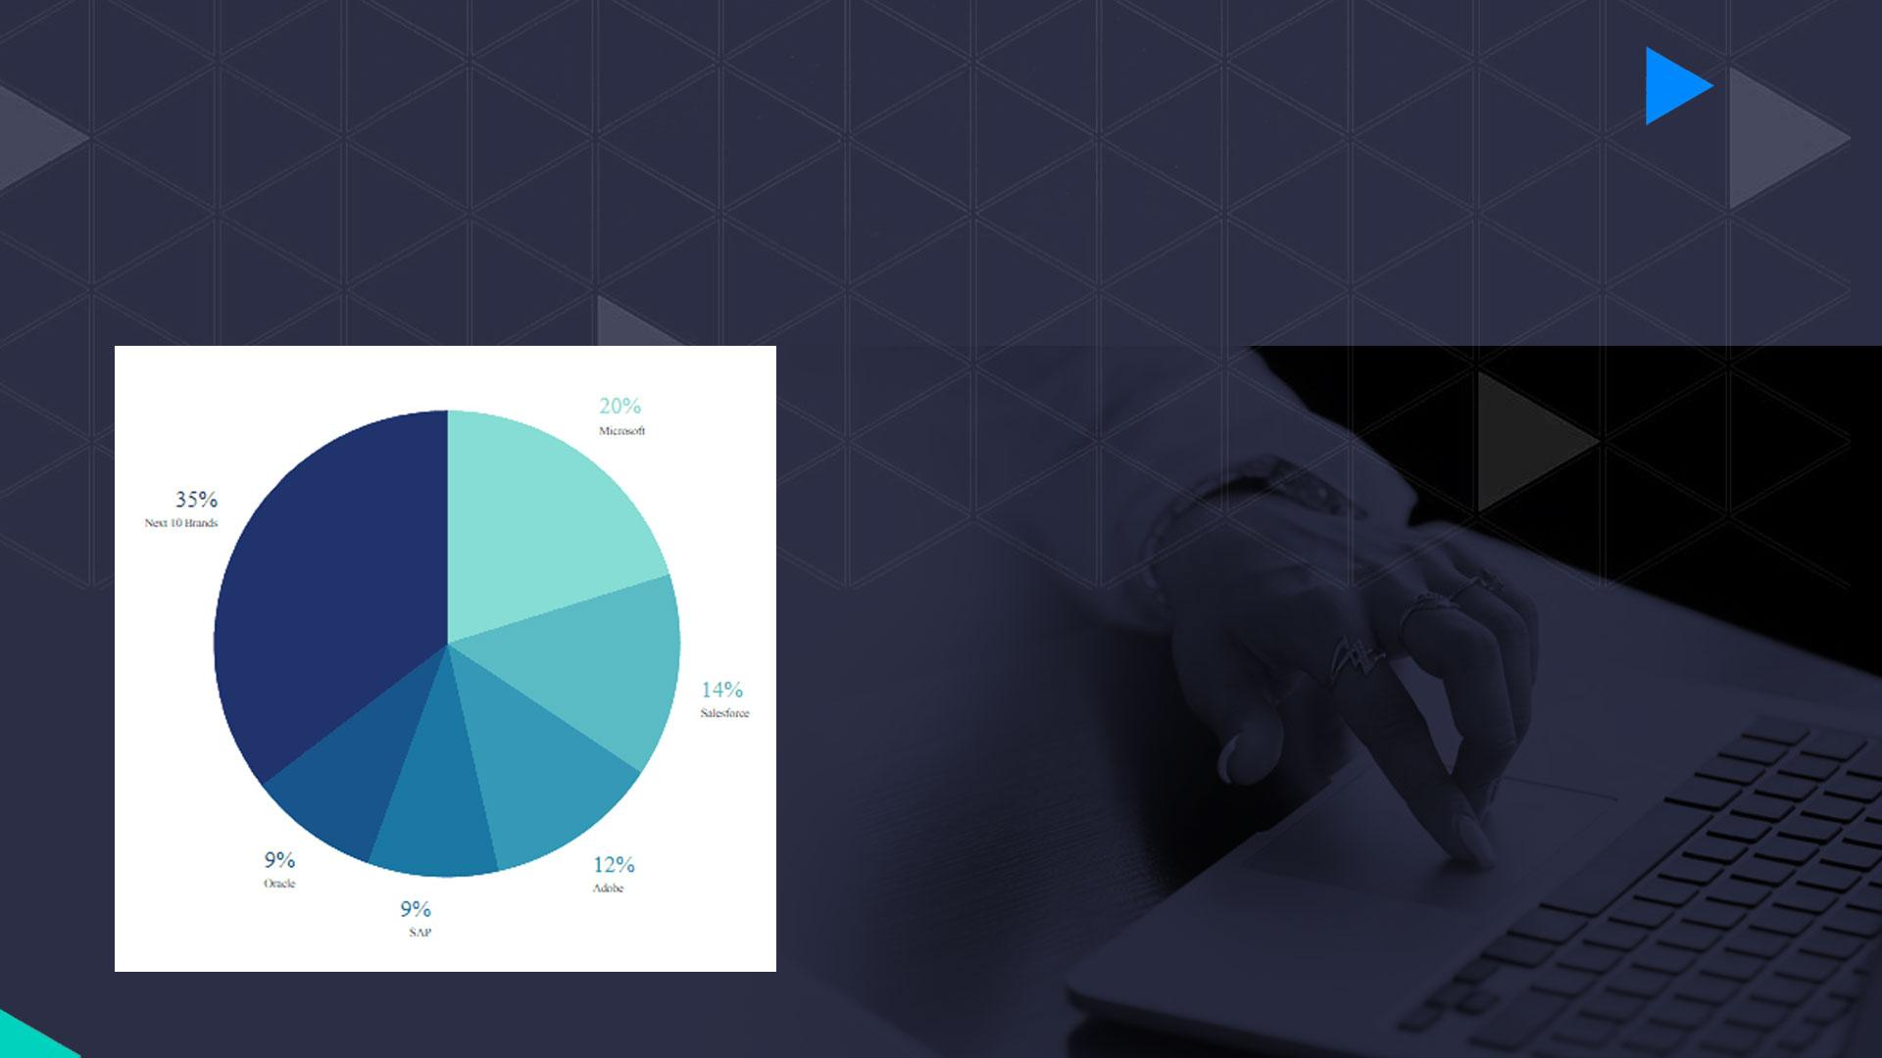
ESTIMATE SAAS INDUSTRY LEADERS MARKET SHARE - 2019
Luckily, the sub-niche that we fall into for this campaign is still relatively infantile and there were not really any direct competitors that were offering the same level of service that we were providing. In this case, the dog-eat-dog mentally was definitely still there, but not enough that it was going to prevent us from doing little more than picking up the scraps of larger businesses that had come before. Building the foundation of our brand helped us to create a name for ourselves and start to build some authority. Now it was up to a combination of authority niche placements, deep link building and link boosting to carry us the rest of the way.

Slide 31
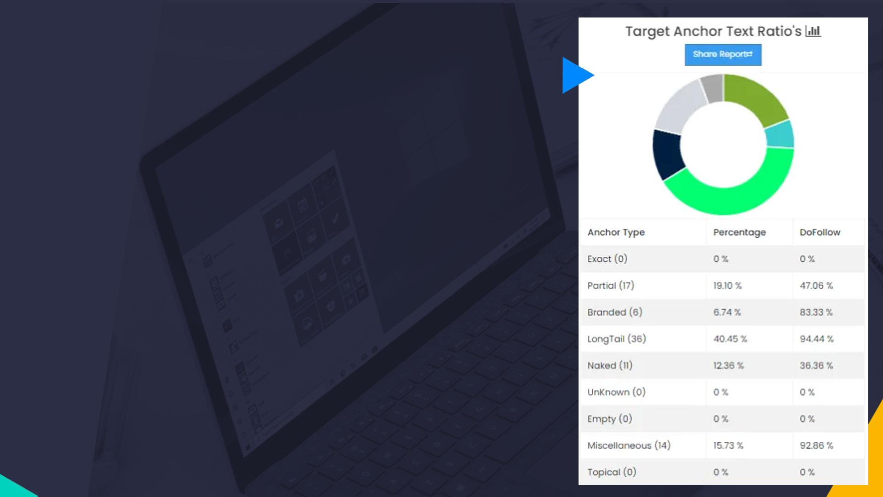
LASER FOCUSED TARGETING
Did you know that there’s a proper time and place for every type of anchor text? You put all the effort into figuring out what keywords you need to rank for, but now you need to figure out exactly where and when it’s safe to use those keywords. After all, building only anchor rich backlinks to your site is an easy way to catch Google’s wrathful eye and incur a manual penalty. We don’t want that. Instead, we use competitor analysis of backlinks, organic keywords, and anchor text in order to determine the best possible ratios of anchor text types for a link building campaign. But that’s not all. Now we take that data, combined with the volatility of the link types that we want to build, to create an anchor text map of various anchor types and target URLs that we’re going to be using throughout this campaign. Perhaps the most amazing thing about this link strategy is that it requires only minor adjustments and checks to keep working, and it can be used for any business.

Slide 32

LINKS
When it comes to our link building, we need to first understand the terms that are being searched for that will bring traffic to our site. Since we’ve already talked about this, let’s look instead at the types of link building that our campaign covered. Primarily, this would be the authority niche placements, where our strategy is geared towards brand + keyword or longtail styled anchor text in most cases. Of course these are our most powerful links as well, so we want to use them to target some of our variation keywords each month in addition to longtail, branded, and other less direct anchor types.
Conversely, when we are building things like social accounts, brand pillow links, or even guest posts, we’re going to be sticking with more brand focused anchors. This keeps the links safe, especially if we are doing multiple in a month, and still provides us with a ton of traffic value. We also want to take this precaution with any tiered links that we create to boost our existing properties.

Slide 33
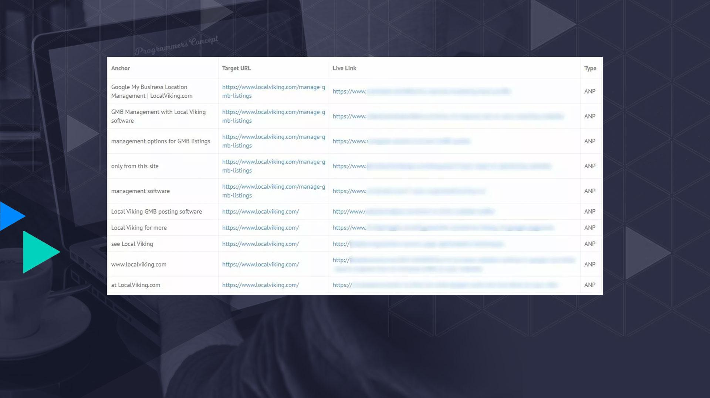
Here you get an idea of the types of anchor text we’re using with our niche placements. We’re early in the campaign here, about month 2 or 3, so we’re still using a lot of brand (especially with the homepage) as well as longtail in our anchor text. But you can also see we’re working in more partial and brand + keyword anchors.

Slide 34
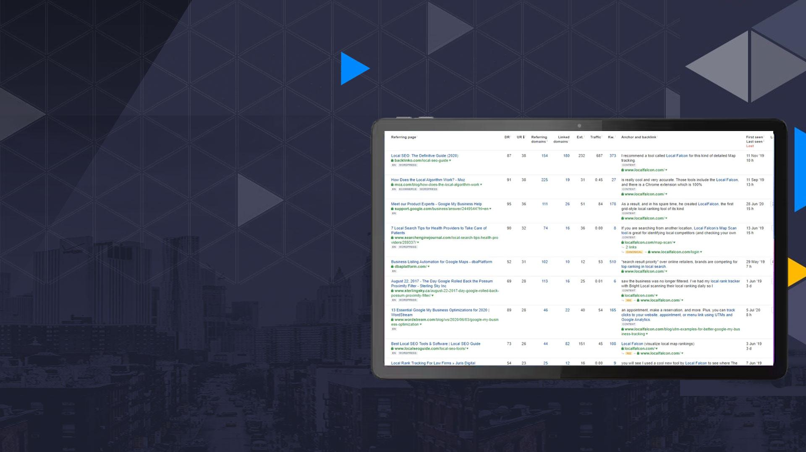
Not all links are created equal. While niche specific links are generally the preference, you shouldn’t choose a link that is niche specific at the risk of poor quality metrics and even an increased spam factor. By basing your link building on competitor parity, you can be sure that your link building efforts are similar to those of your competitors. But that doesn’t mean that you should build every single link that your competition has built. ALWAYS, ALWAYS evaluate link opportunities before seeking placement.
Here is an example of a competitor for the term ‘LOCAL RANK TRACKER’. You can see there are a lot of niche specific and authoritative backlinks here, making this a profile that we certainly will want to try to emulate.

Slide 35

CONTENT
FRESH CONTENT is a powerful resource for driving traffic to your site. We included one 500 word piece of content each month, based on competitor data and current industry trends. A monthly content refresh would help to drive more targeted traffic by answering the types of questions that were leading searchers to other similar platforms. New content would also show Google that our site was regularly updated, which they do tend to reward.

Slide 36

When you create great content, you open yourself up to even more opportunities for generating traffic and growth. Internally linking your post to a relevant top tier page of your site will allow you to create deep link opportunities. These pieces of content, generally blog posts, can then be used for additional link targeting. Add a link to an authority site within the text and you also add a little trust point to your piece. By researching the topics and questions that searchers are trying to answer for a particular type of query, you allow yourself to create a content plan that answers these concerns and in turn makes you a more authoritative industry source. Aside from checking out what your competitors are writing, you can also check out the People Also Ask section of Google search results to see what searchers really want to know.

Slide 37

CONTENT SOLUTIONS also pertain to our existing page content. We need to make sure that the pages we already have on the site are being benchmarked against the top ranking sites insofar as keyword density, word count, and content structure. From here, we also need to make sure we’re targeting our relevant terms at a safe ratio. And we want to check that we’re not optimizing our page for terms that might rank better for a different page of our site.

Slide 38

SEMANTIC OPTIMIZATION helps us to write content that is more conversational while still hitting it with some great SEO. We’ll look at synonyms and trends data, too. Conceptual tiers, audience profiling, and leveraging internal linking are also part of the semantic optimization that we perform on a page. Latent semantic optimization helps us to hit all of these points in our on page work, we just need to make sure that we’re also taking the time to check out how our competitors are structuring their pages as well. In the end, this makes sure that our pages are well optimized for the search intent that we are targeting. Including contextually relevant keywords and topics, like those mentioned in the ‘People Also Ask’ section of search results.

Slide 39

CONNECTING WITH
YOUR TARGET AUDIENCE
That’s what it’s all about, getting in front of the people who most need your services. This particular software is pretty niche; we have a very specific target audience and we know exactly what they’re looking for, even if they aren’t quite sure of it yet. But that doesn’t mean we can go getting cocky about it early on. Without putting ourselves in front of these people, it’s a toss up as to whether or not they would eventually stumble across our brand and like what they see enough to get involved or reach out. That’s not something that you should ever just leave to chance; that’s like throwing money out the window and hoping someone brings it back to you. So instead of relying on the “Build It And They Shall Come” mentality that served digital marketers at the dawn age of SEO, we’re going to have to put in the work for our acquisitions.

Slide 40

PART 4 :
RESULTS
THAT
MATTER

Slide 41
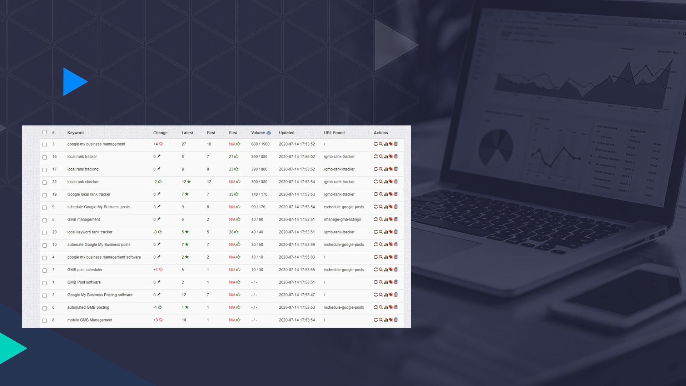
POWERFUL, POINTED LINK BUILDING
At the end of the day, what matters are those sweet, sweet results that you’re able to bring in for your client, no matter how large or small their budget. In this case, we took on a major ranking project on a budget of just over $800 monthly. And not only did we rank over three quarters of our core target keywords in the top 10 results, we simultaneously crushed the acquisition costs of our organic leads to just $5; you can’t even buy a particular length of sandwich for that price, if you catch my drift.

Slide 42
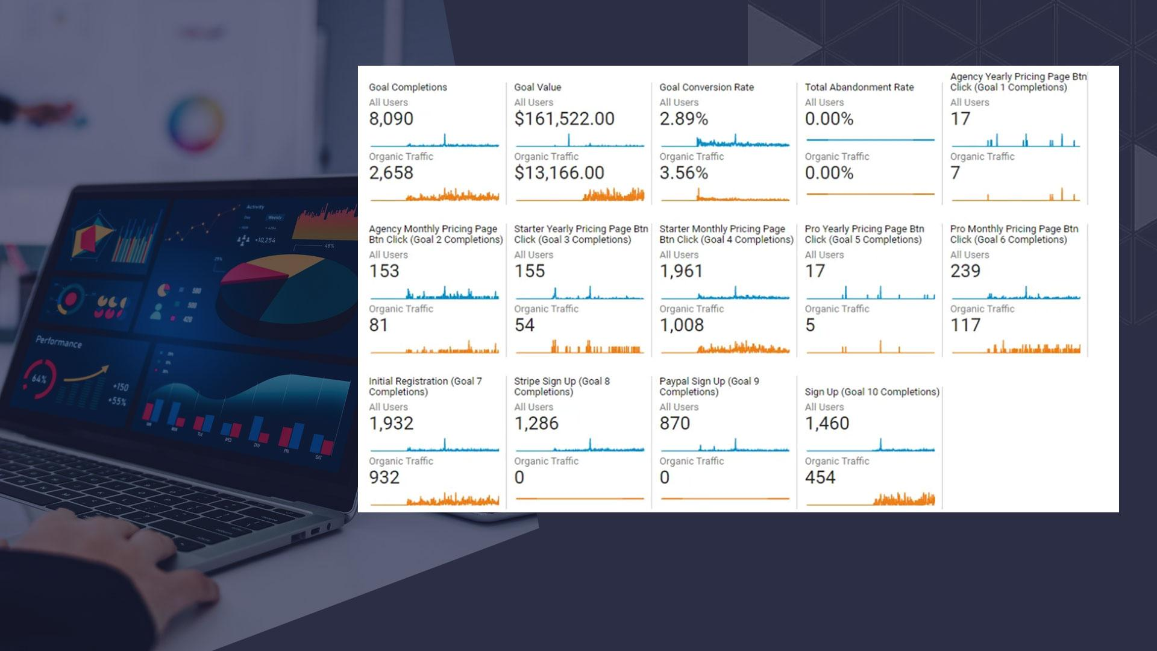
From the idea to create a better GMB software to the 14 months that we spent investing in our SEO, we’ve finally seen this thing through to fruition. And the end results are every bit as awesome as we could have hoped.

Slide 43
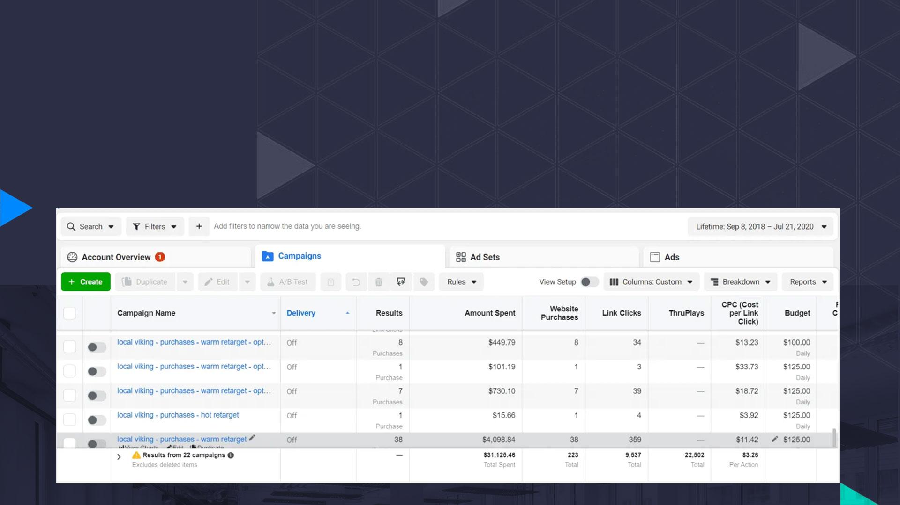
CRUSHED ORGANIC CLIENT ACQUISITION COST
The biggest ROI for this campaign by far was our ability to bring down the cost of an acquisition through organic search traffic to just a couple of dollars. But how impressive is that number, really?
Turns out, it’s mighty impressive.

Slide 44

For SaaS businesses, you’re probably going to run a lot of ads; it’s the nature of the beast. We chose Facebook as our ad platform of preference. While it has it’s pros and cons, it is definitely not known for being a cheap marketing tool. For paid ads, our cost per conversion was a whopping $139.57 average for the duration of our campaign. And an average means there were certainly times when we spent more. We expected the ads to do a little better than they did perhaps, but were absolutely floored by the amount of leads and conversions we were seeing on the organic side.

Slide 45

When you take a moment to run the numbers, that’s a 96% DECREASE in our client acquisition costs from ads to organic. Combining that with the overall increase in new organic sign ups per month that the SEO has helped to generate, we’re seeing a very lucrative campaign that, with the right upkeep, is going to put us in a great place for future growth.
At the one year mark, a lot of software companies are still barely breaking even. Thanks to the managed SEO campaign’s extensive link mapping and acquisition tactics and content creation strategies, we’re doing a lot better than breaking even.

Slide 46

NEW SIGNS UP
Another big goal that we had set for this campaign was to increase the number of new sign ups to our platform per month. A goal that most businesses are going to have in common. Starting out, we had no new sign ups for the first few months. This isn’t a great thing to see, but it’s at least somewhat expected for a new brand where we’re still building up the entity strength. Comparing that to our current goal metrics, we have a much better ROI that we can run with. Current monthly sign ups from organic search traffic stand at 454, about one quarter to one third of our 1460 total monthly signups.

Slide 47

Taking a look back at where we were standing early in the campaign, our total monthly traffic value was $6700 and NONE of that value was coming from organic search traffic. Of course analytics numbers can be a bit off, but obviously the little traffic we were getting was coming from elsewhere. Currently, you’ll see that $13,166 is our monthly traffic value from organic search results alone, of our total monthly traffic value of $161,522. This doesn’t directly correlate with the amount we’re spending to acquire each lead, but it gives you another look at how organic SEO with the right team can really crack a tough site wide open.

Slide 48

ORGANIC KEYWORDS
We can’t neglect a mention for how well our terms are ranking, those with high search volume and those without. Organic traffic is all about the keywords; it’s how searchers and search engines know that your site is relevant to their query. By making sure that we were effectively optimizing our link anchors and the content on our target pages, we created a strong relevance for not only our target terms, but subsequent variation and longtail terms as well.

Slide 49
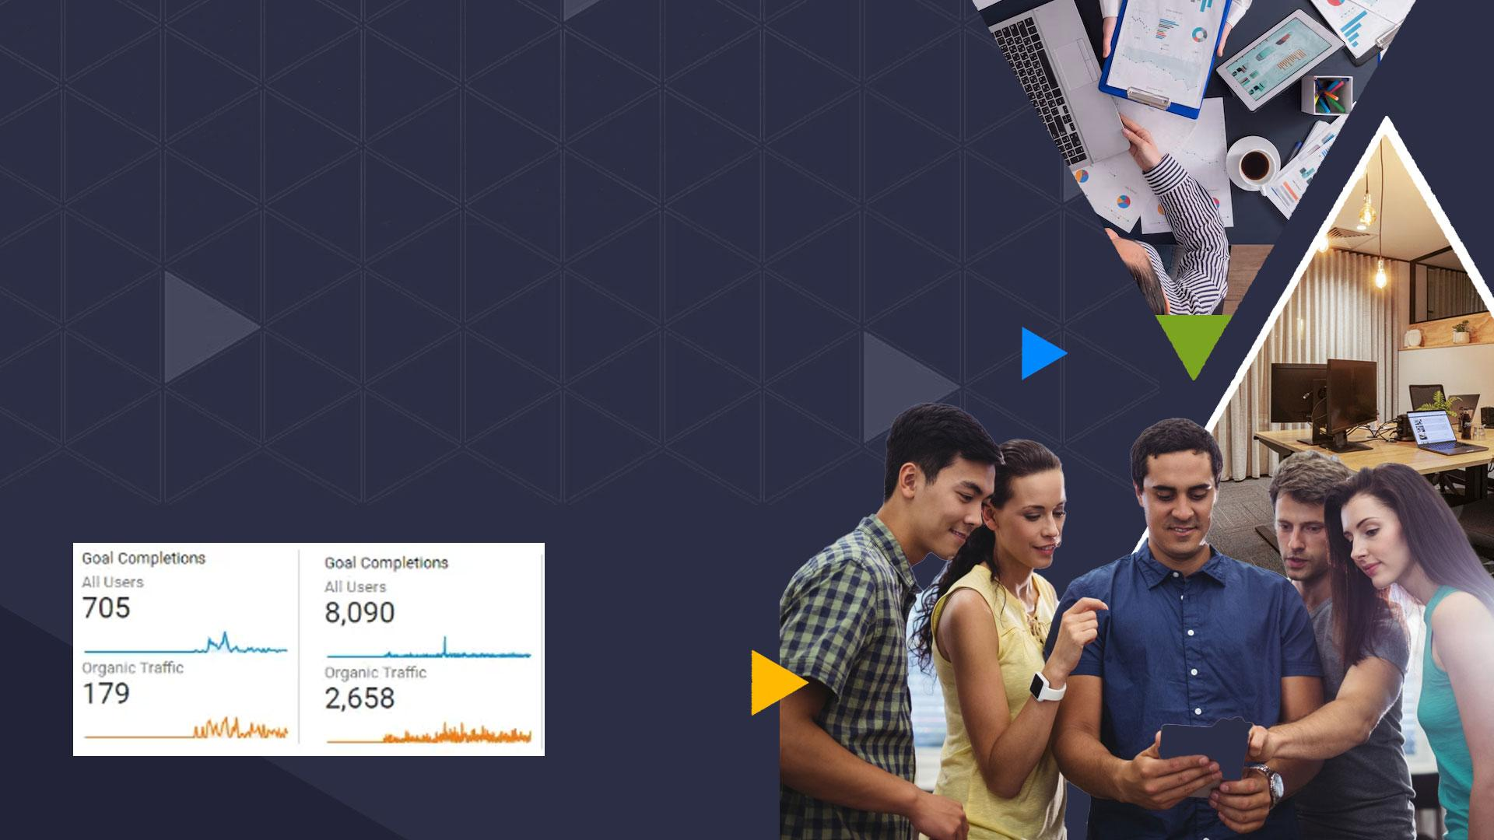
TOTAL ORGANIC GOALS
COMPLETED
Overall, we’re seeing strong goal increases across the board. Through the first quarter of the campaign we saw about 705 total monthly goal completions, with 179 of these being organic specific. In the final two months of our campaign we had 8090 total monthly goal completions, and 2658 of our total completed goals each month are coming through organics.

Slide 50

CLOSING THOUGHTS
When you launch a new SaaS, there are tons of things that you need to consider in the short term and the long term. From how you’re categorizing and utilizing your anchor text, to building the right type and amount of links every month, your strategy needs to be a cut above the rest. But does that mean you need to break the bank in order to put your business at the top? No. Or at least, not always. In this case, we put a lot of top level work into a campaign that had a smaller budget than what would be ideal for the industry, and we were able to get fantastic results in a manageable timeframe to boot. If you’re considering SEO for your business, there’s no better hassle free solution than White Label Organic SEO.

