Slide 1



LOCAL SEO CASE STUDY
FOR A MULTI-LOCATION
FRANCHISE BUSINESS
IN THE SPORTS MEDICINE INDUSTRY

Slide 2


TABLE OF CONTENTS
Highlights Of This Local SEO Case Study
About the Client
So, What Did We Do?
We started by Analyzing
Challenges Found During Local SEO Audit
What Competitor Research Showed Us
The Local SEO Strategy/Plan
The Results We Achieved
GMB Insights
Geo-Grids Visibility
Rank Tracker Results
Mid-Size Locations Results
What's Next?
Conclusion
Get Results Like these for Your Business...

Slide 3


In this case study, we will analyze the Local SEO approach that brought dominating results in the Local Map Pack and Organic SERPs for our multi-location Franchise client.
For about 6-7 months, we have seen how the results in visibility improvement have led to an average of 351% INCREASE IN PHONE CALLS across all locations.
This period has also made it possible for us to rotate between focus keywords and achieve dominating Visibility in Maps and SERPs for a broad range of highly-searched money terms for this multi-location franchise.

Slide 4



Niche: Sports Medicine
Search volume total of focus keywords: 200K/month
Average CPC for the target keyword: $17.97
Population sizes of target locations vary between
250,000 to over 2 million
Search Volume for Main Term: 41K/month
Competition Level: High
Achievement: Ranking in Less than
7 Months
HIGHLIGHTS OF THIS
LOCAL SEO CASE STUDY

Slide 5



ABOUT THE CLIENT
The goal was to increase the online visibility and, in turn, revenue for all locations.
Aside from the Local SEO efforts they planned to make, they had also been actively running Paid Ads. However, they were not overly pleased with their current results.
Not being able to rely on cost-effective organic traffic wasn’t a sustainable situation for long term success.
The idea was to get started with a Local SEO Strategy for their, at the time, less than 100 locations. Due to marketing budget constraints at a corporate level, we had to reduce the campaign to our Basic Local SEO Plan and decided to check back on results after a quarter to determine how we would be moving forward with our partnership.
We now manage over 170 ACTIVE LOCATIONS, and the franchise is continuously growing, opening more locations, and expanding their services.

Slide 6



WE STARTED BY
ANALYZING:
Technical SEO/Website Issues
On-Page SEO
Backlink Graph
Citations
NAP Consistency
GMB Listing Issues
Content Analysis
Competitor Research
SO WHAT DID WE DO?
To quickly have the data available, on our first month, we ran our detailed Local SEO Audit to determine the exact issues that would help us compile the plan and strategy to move forward with.

Slide 7


CHALLENGES FOUND
DURING LOCAL SEO AUDIT
The franchisees had their own domains
The content was very thin across these domains, which meant more optimized content was needed for all franchisees
Low Visibility
Low Brand Authority
Low Niche and Geo Relevance
Lack of On-Page Optimization
Possum Filter Issues for GMB Listings
Low Number of Backlinks
High Competition, especially in Densely
populated areas
Lack of GMB Optimization
Technical SEO Issues
Anchor Text Ratios

Slide 8


SOME OF FRANCHISE’S
BUSINESS LOCATION:
San Antonio
Raleigh
Kansas City
Charlotte
Fort Worth
Tucson
Miami
Salt Lake City
Philadelphia
Jacksonville
Orlando
Atlanta
Beaumont
Louisville
Houston
Indianapolis
Albuquerque
Pittsburgh
Oklahoma
Phoenix
Omaha
Austin
Wichita
Nashville
Cleveland
Corpus Christi
Lexington
Aurora
Tulsa
Columbus
Colorado Springs
Portland
Boston
Memphis
Cincinnati
Dayton
Dallas

Slide 9


WHAT COMPETITOR
RESEARCH SHOWED US
Upon conducting competitor research, we quickly deduced that we were facing strong, authoritative competition for the niche and our locations, which were already well-positioned in Maps and SERPs. The majority had been in business longer than our client and were already doing SEO. Competitors showed extensive link graphs, citations, and site content, as well as a larger number of reviews, among other things.
During this phase, we also uncovered where to focus to CAPITALIZE ON QUICK WINS, while at the same time investing in long-term success.

Slide 10


THE LOCAL SEO
STRATEGY/PLAN
Considering the issues found during our Local Audit, we started mapping out our ACTION PLAN AND EXECUTION. The first thing we wanted to set into place was fixing the technical SEO Issues encountered.
As mentioned, our client had individual domains for all franchisees/locations and very thin content throughout all of these domains. Fixing the issues meant having one dynamic root domain and individual location pages for every franchisee. This way, every franchisee had rights to the location pages while benefiting from the authority and relevance passed over from the root domain.
At the same time, we worked on solutions to eliminate the issue of duplicate content.

Slide 11


Next, we went on with Keyword Research and On-Page Optimization for all location pages. We focused on highly relevant and searched transactional intent keywords. These terms are perfect if the searcher wants to set an appointment and know more about the services offered.
This process also provided direction for
Content Silos
Internal Linking
Then, we fixed On-Page elements like
Title Tag
Heading Structure
Meta Description
Image Optimization
Adding Keyword Variations,
Optimized Content

Slide 12



We know that not optimizing, at least the location pages connected to the listings is FUNDAMENTALLY FLAWED. To make location pages geo-relevant, we also worked on adding website features such as:
Find Us Locally Section
Local News
Relevant Points of Interest
Outlinks to Local/Niche/Authority Sources
If you’d like to get more granular in understanding what would make an excellent location page, check out this Location Page Audit Checklist For Local SEO that outlines every element and detail in an easy-to-understand format.

Slide 13


After fixing the above, we started working on Brand Authority and Link Acquisition to cover OFF-PAGE SEO. This involved:
Press Releases
Do-Follow News Releases
Local & News Link Building
Business Profile Creation
Niche & Local Citations
Maps Citations
GPS Listings
Social Citations
Supporting Citations
Tiered Links for Stacked Signal Creation
Brand Foundation, and Brand Signal Building
Custom Signals on parity with Competition
Geo and Niche Relevant Networks
Patch Listings and Articles
Patch Featured Events

Slide 14


Bear in mind this is not just one location or a handful that are getting optimized simultaneously. Our agency’s capacity and SOPs allow for Bulk Onboarding, as well as the implementation of these complex audits and strategies. We have seen great results in short periods of time for this franchise for over 100 listings using strategies that we lay out here. Keep reading as we showcase those results in screenshots and ranking proof, direct from GBP insights, GEOgrids, and our local keyword rank tracker.
For the campaign’s second quarter, we decided to expand the radius coverage on locations and keywords, targeting larger cities for other smaller locations and rotating and switching between focus keywords once we had them ranked.

Slide 15


IMPACTFUL RESULTS AFTER
8 MONTHS
Overall average Local SEO metric and KPI increases
considering all 100+ locations:
Views on Search increase +408%
Views on Maps increase +227%
Driving Directions Requests increase +260%
Phone Calls increase by +351%
Visits on the Website increase by +362%
Posts Views on Search increase +1019%
Actions CTA on Posts increase +100%
Direct Queries increase +230%
Indirect Queries increase +366%
Chain Queries increase +356%
** There are locations where these increased percentages are double the average presented above.

Slide 16

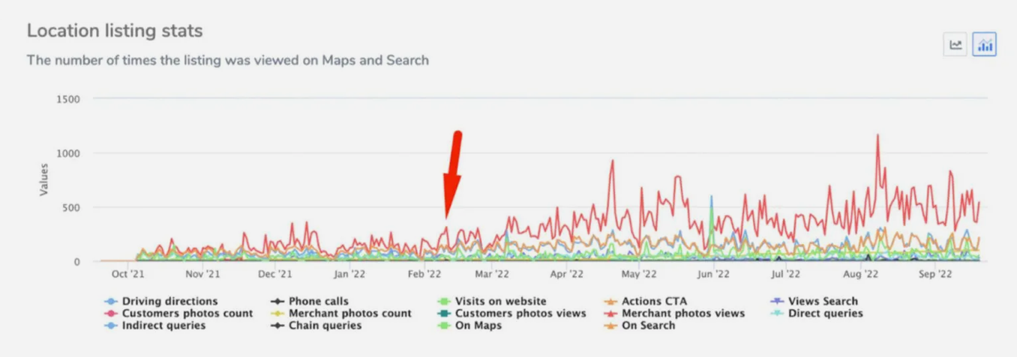

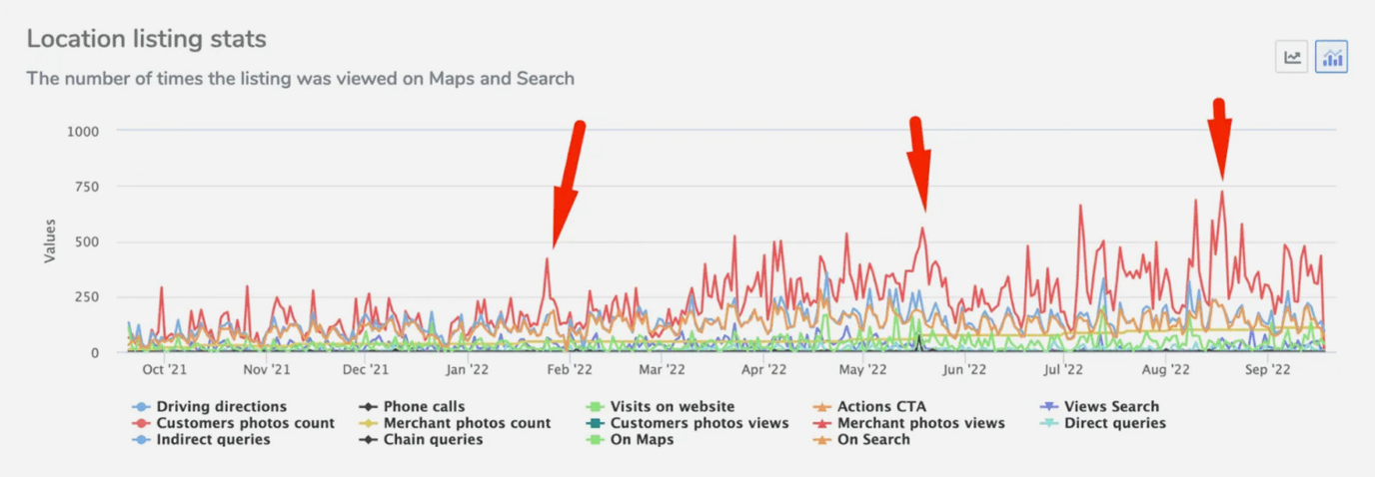
HOUSTON
GMB INSIGHTS
SAN ANTONIO

Slide 17

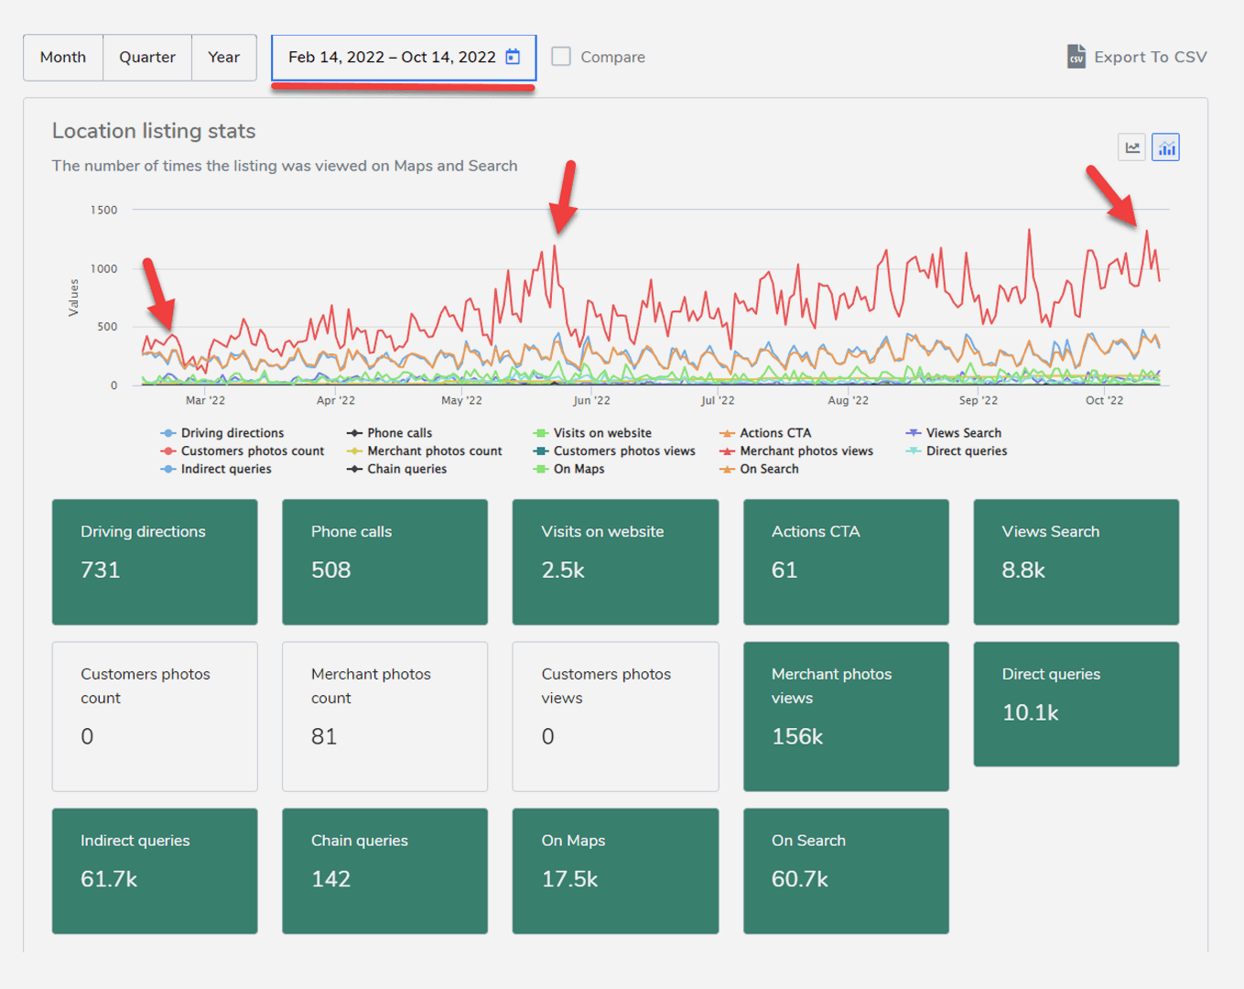
GMB INSIGHTS

Slide 18
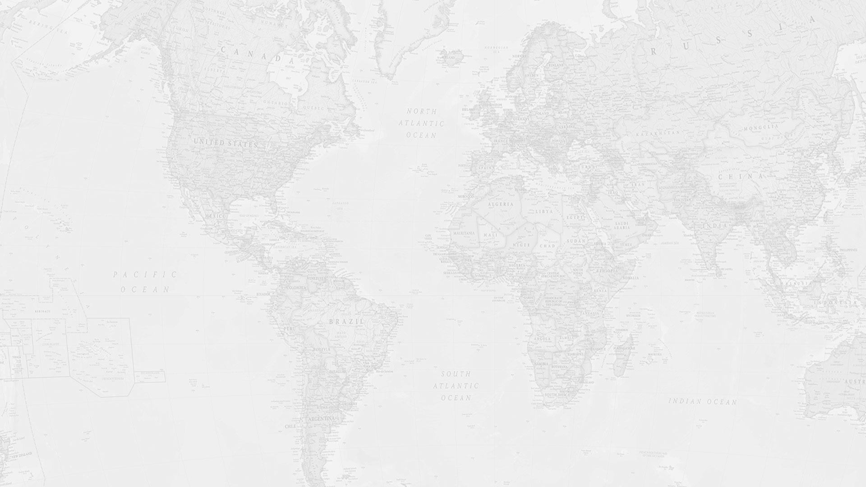

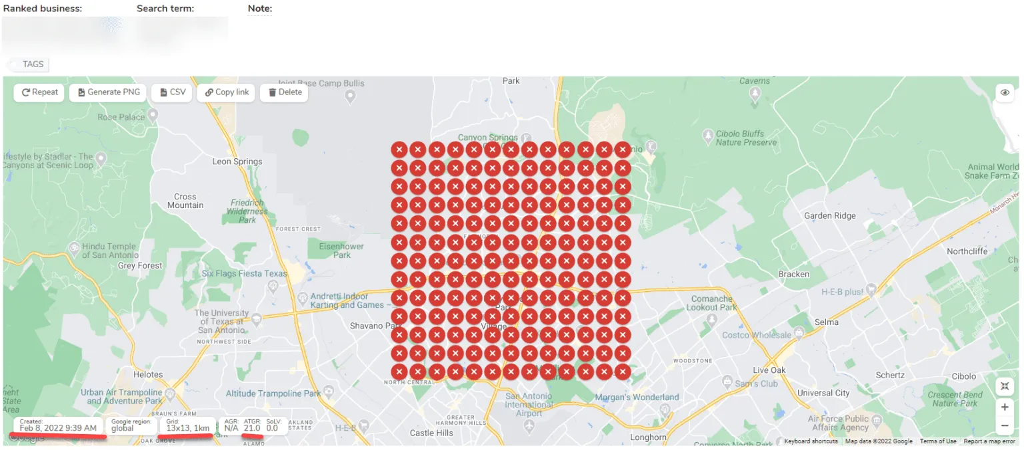
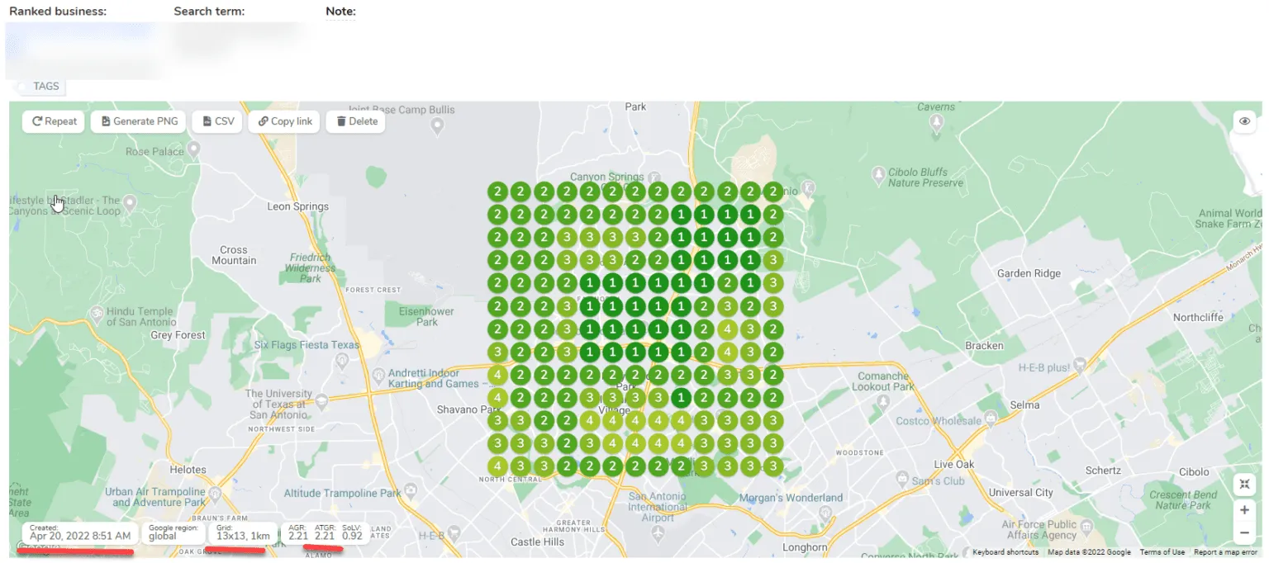
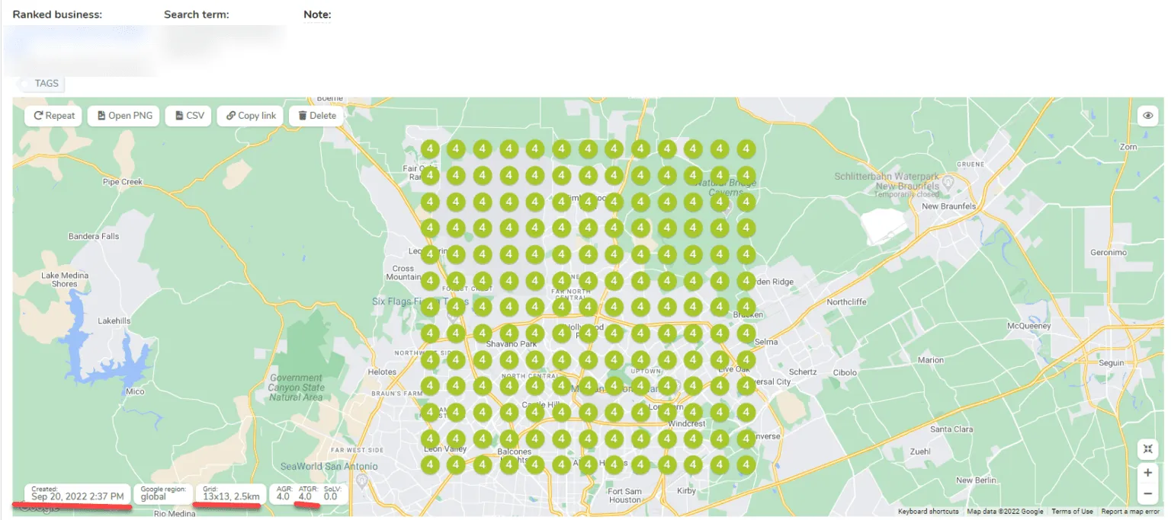
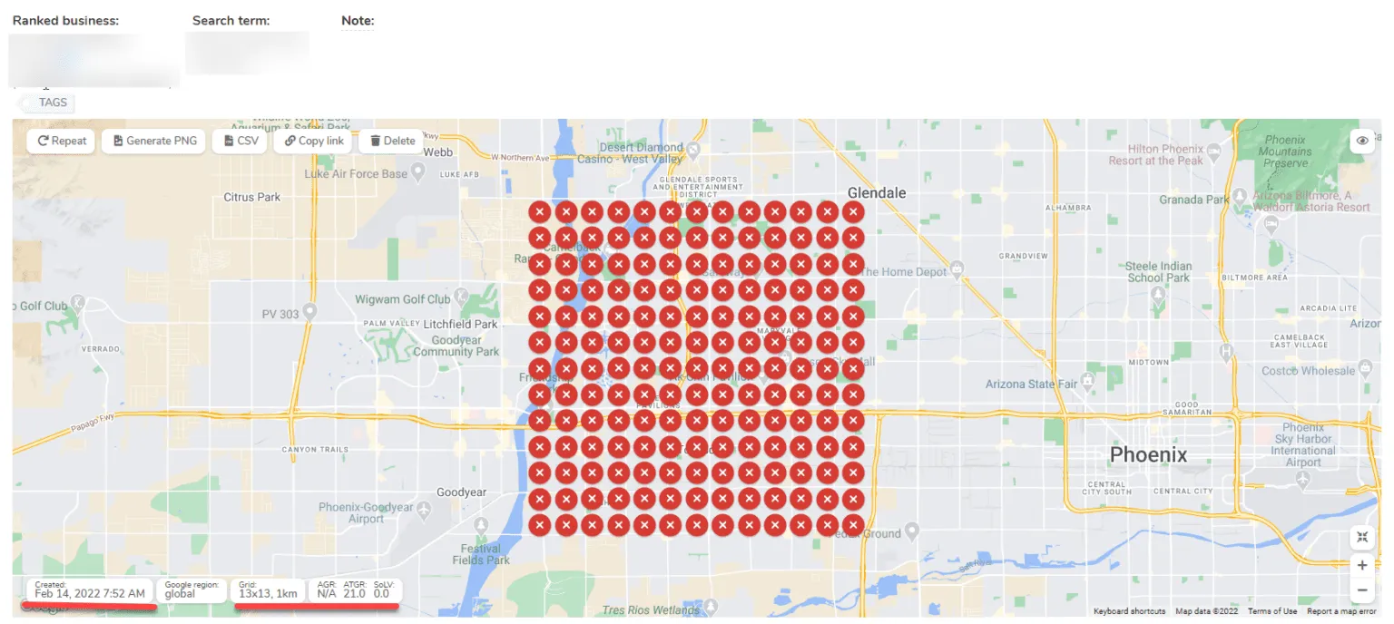
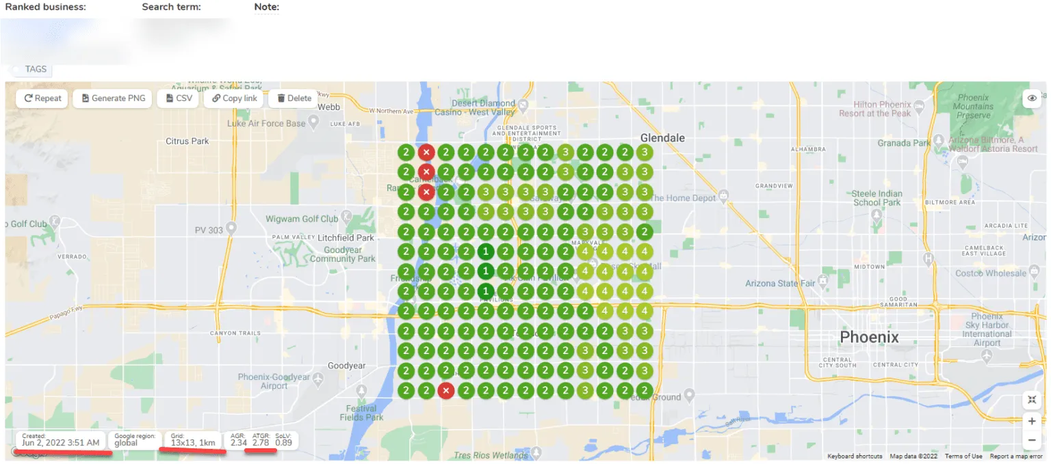
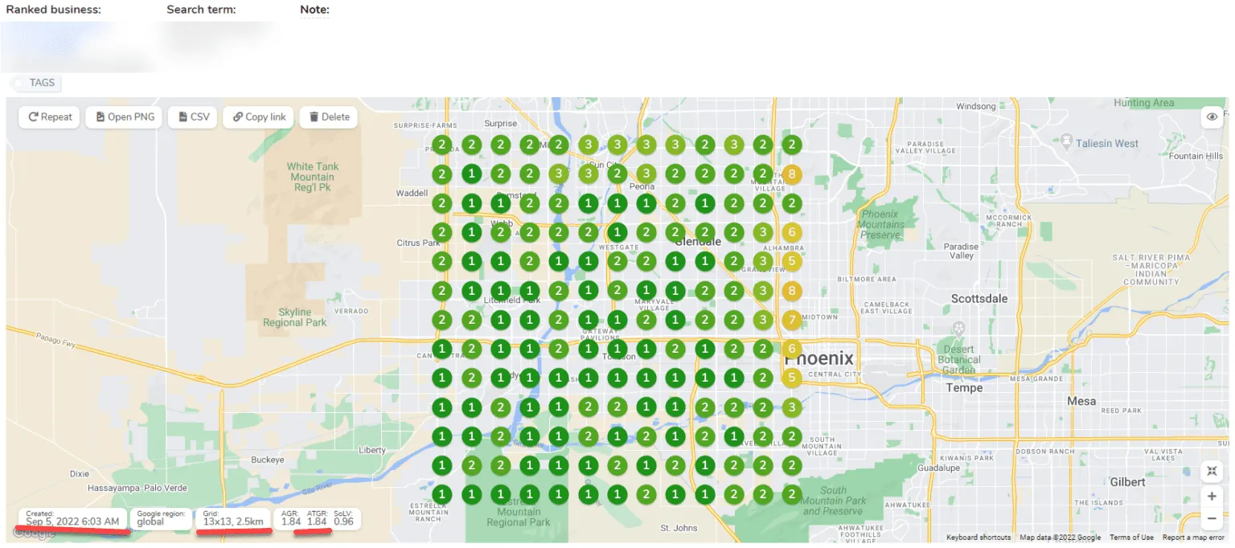
GEO-GRIDS VISIBILITY
To maintain anonymity for the client, we will not expose the business’s name and target keywords on these images. Still, the images below show you the exact keyword at three periods in densely-populated areas.
1
Keyword Maps Visibility and position in 1 km grid scale for San Antonio TX in Feb 8, 2022.
2
Keyword Maps Visibility and position in 1 km grid scale for San Antonio TX in Apr 20, 2022.
3
Keyword Maps Visibility and in 2.5 km grid scale for San Antonio TX in September 20, 2022.
4
Keyword Maps Visibility and position in 1 km grid scale for Phoenix AZ in February 14, 2022.
5
Keyword Maps Visibility and position in 1 km grid scale for Phoenix AZ in June 2, 2022.
6
Keyword Maps Visibility and position in 2.5 km grid scale for Phoenix AZ in September 5, 2022.

Slide 19

WHAT’S NEXT?
The visibility improvement directly influenced INCREASES IN CALLS, SITE VISITS, CONSULTATION REQUESTS, and driving directions for the franchisees.
As the franchise continues growing and planning on releasing new services, we are working together in conducting keyword research for the right audience and planning the strategy to implement soon.
We will be continuously monitoring and reporting the progress to keep improving engagement, measure the overall campaign performance, and more easily detect patterns, as well as set goals and plans to make decisions.

Slide 20


CONCLUSION
Identifying the important KPIs and implementing consistent reporting is paramount for keeping corporate and franchisees happy. Being able to convey reporting concisely is also important, and this kind of one-to-one support is paramount to keeping a corporate entity in the loop. Our agency is able to the support your franchise needs to succeed!
We jump on calls to answer questions from the franchisees on behalf of our corporate client. We are proud to be able to offer that kind of guidance and support to our clients and their members alike. Helping businesses grow and tap into the SEO resources we’ve curated over the years is why we are here!

Slide 21



GET RESULTS LIKE THESE
FOR YOUR BUSINESS…
Set your business up for the best opportunities to rank with our Monthly local SEO services.
You can email us at {your email} to learn more.
We also provide Free Campaign Recommendations and Audits to narrow down the best services for your business!

